Slide 1
Create & Use Your Own Teaching Website
Bjorn Candel – Fujairah Men’s College

Slide 3
Go to www.kahoot.it

Slide 4
Here are some different ways to communicate with your students and deliver your classes

Slide 5
7 advantages of creating your own open class website
No apps to download for students
No passwords to remember
Opens on any device connected to the Internet
You have full control over page organisation and navigation
Easy to make visually striking & appealing
Easy to share with others
Easy to collect assignments & projects

Slide 6
3 disadvantages of using an open class website
No tracking
Except for number of views!
No built-in annotation tool
No shared space for collaboration
Except forums and blogs!

Slide 7
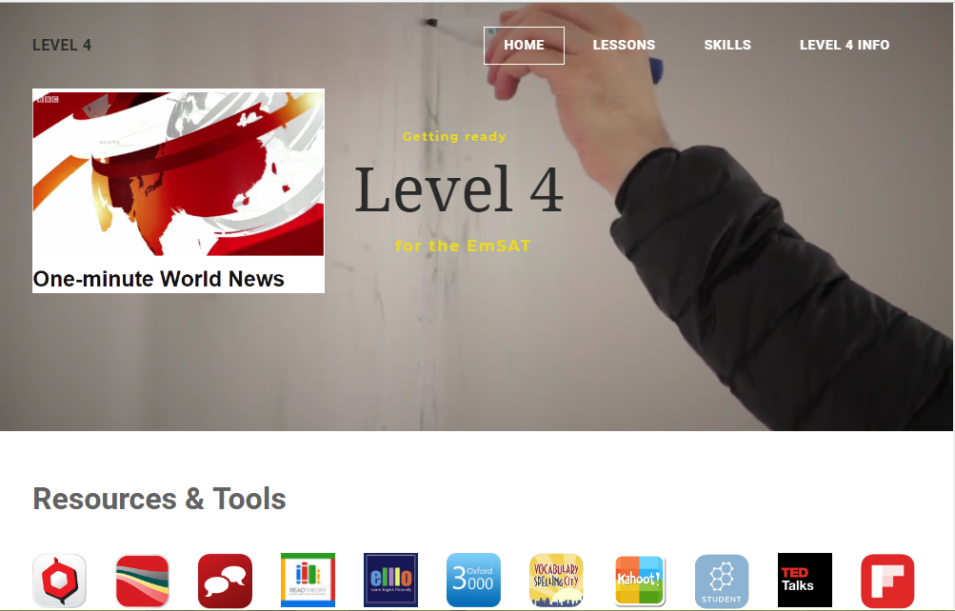
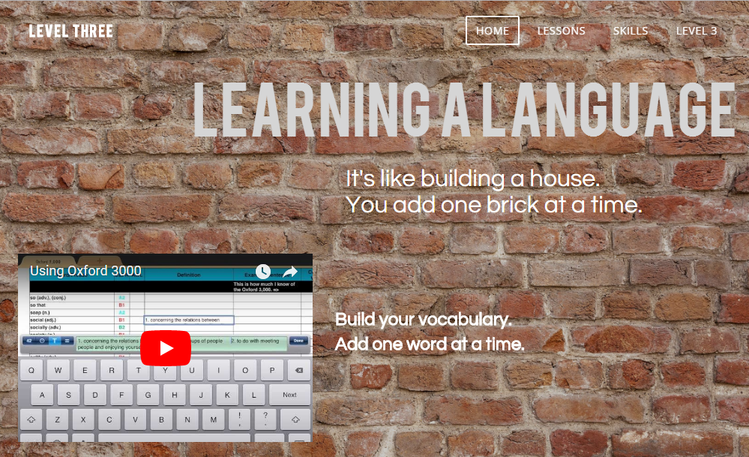
Using a Teaching Website
Check these ones out!
http://level-three.weebly.com/
http://levelfour.weebly.com/

Slide 8
Let me give you a guided tour!

Slide 9
Build Your Own Teaching Website
Sign Up & Choose a Theme
Edit and Add Text
Add Images
Expand and Organise Your Page Structure
Build Your Own Template Page and Duplicate It
Add Files and Links
YouTube Videos and Photo Galleries
Layout Issues
Collecting Assignments & Projects
Set Up Websites for your Students!

Slide 10
Sign Up and Choose a Theme
01

Slide 11
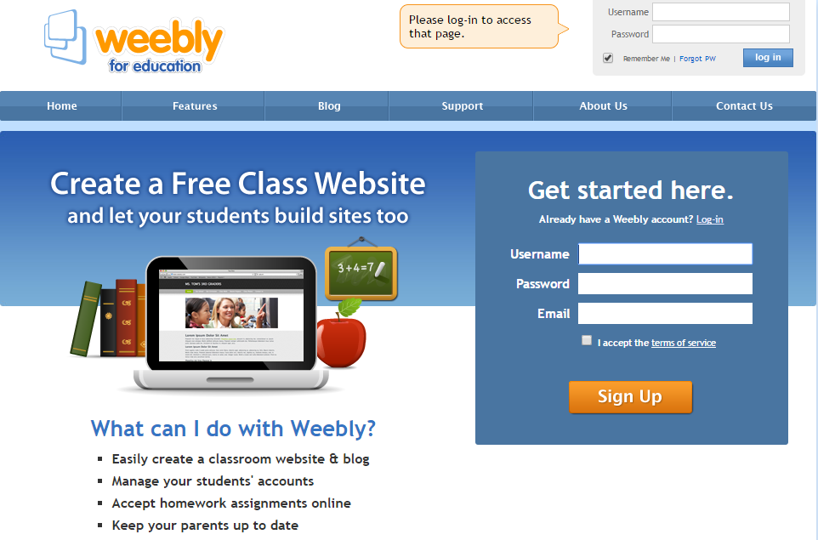
Sign Up @ https://education.weebly.com

Slide 12
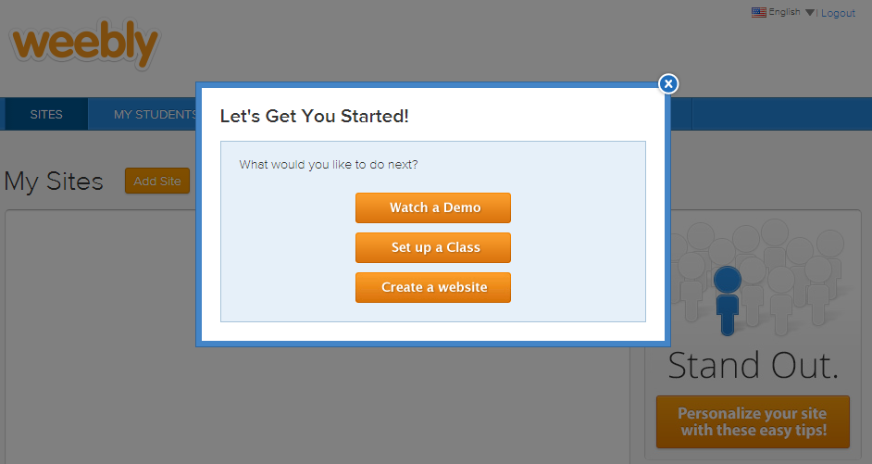
First, select Create a website

Slide 13
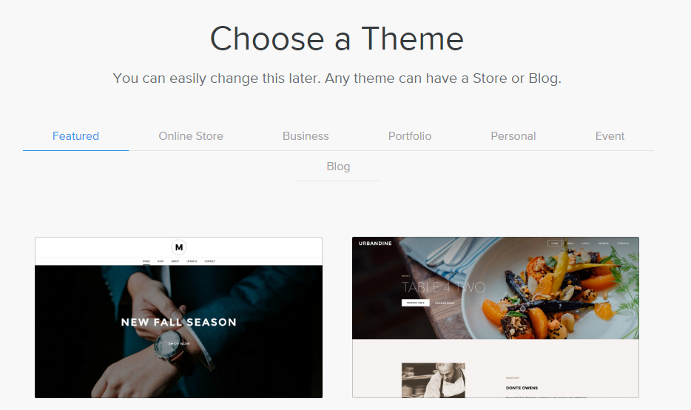
Next, Choose a Theme

Slide 14
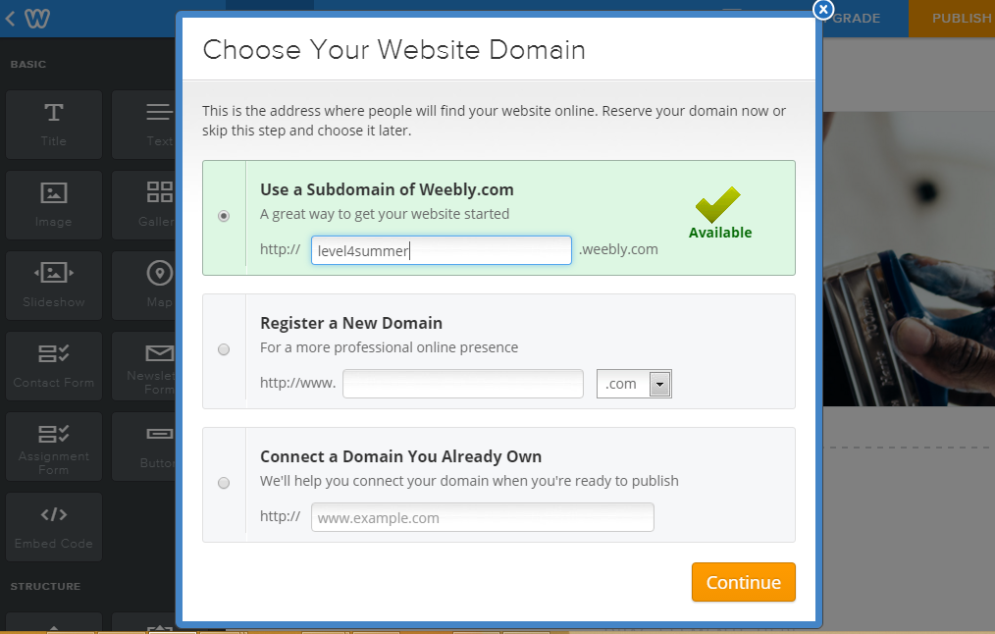
After that, decide on a Subdomain Name

Slide 15
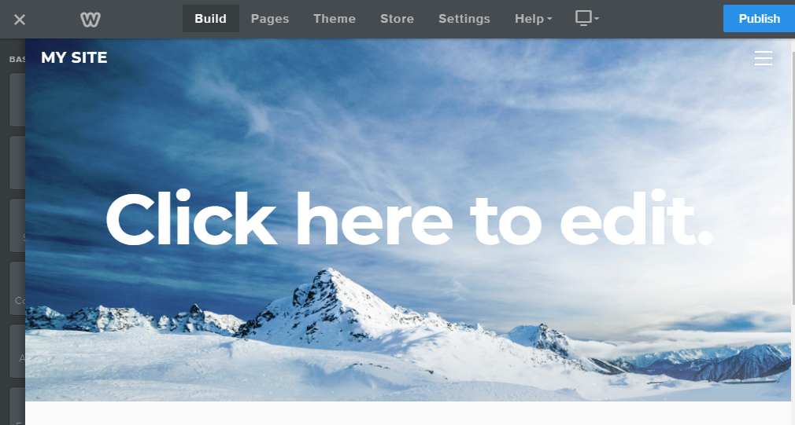
You’ve now got a website with a web address

Slide 16
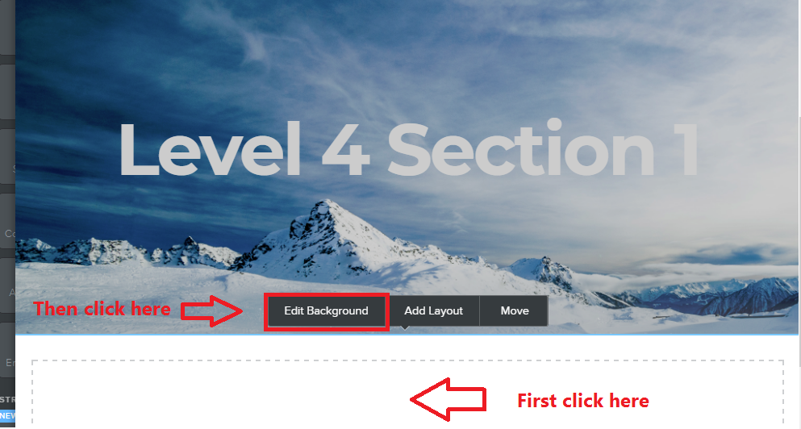
If you want to change your background image
Click below the current image
Click on Edit Background
Choose Image or Video and make your selection

Slide 17
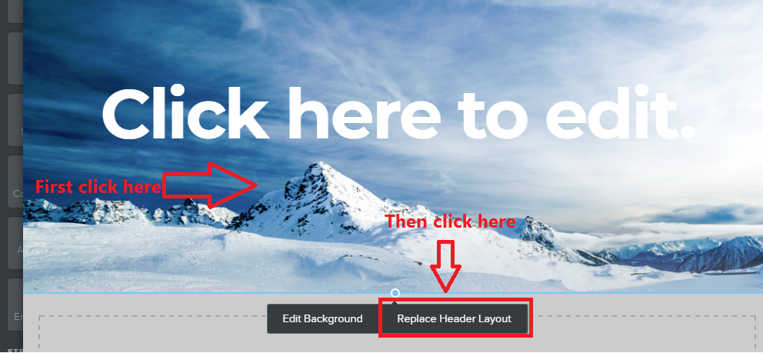
If you want to change the layout of your landing page
Click on the main image
Click on Replace Header Layout
Select a new layout
NB. It might be easier to choose a new theme with a landing page you like better

Slide 18
Edit and Add Text
02

Slide 19
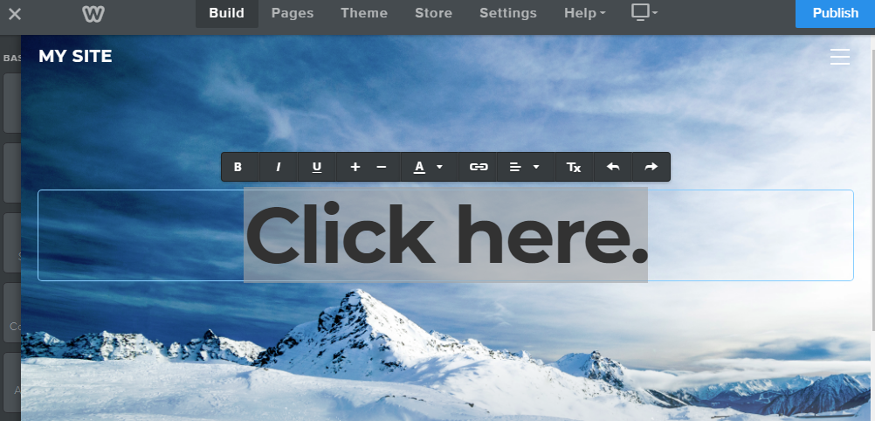
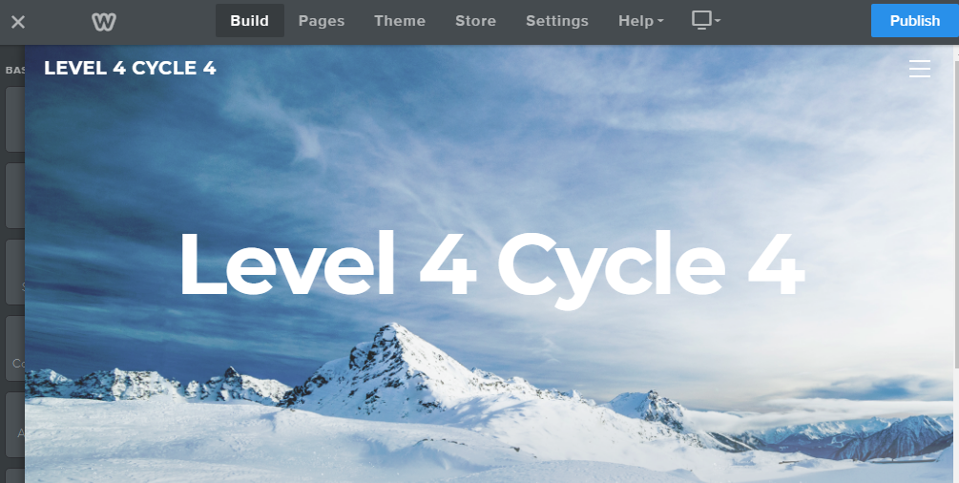
Highlight and Edit any template text

Slide 20
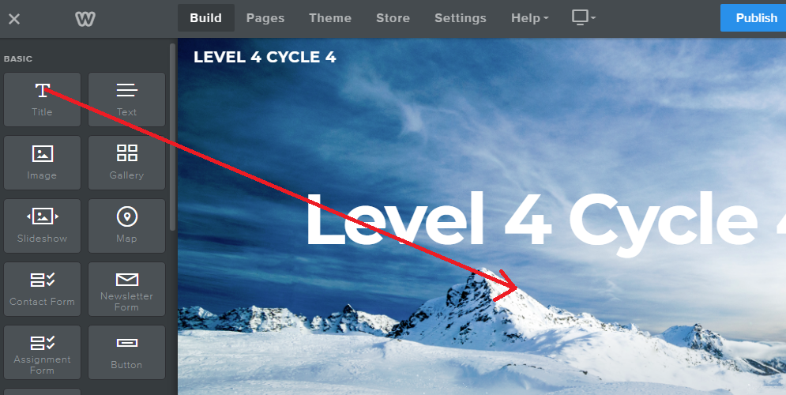
Drag a text tool to where you want it on the page
Type your text
Select your text and use editing tools to change font size, colour and attributes like bold and italic

Slide 21
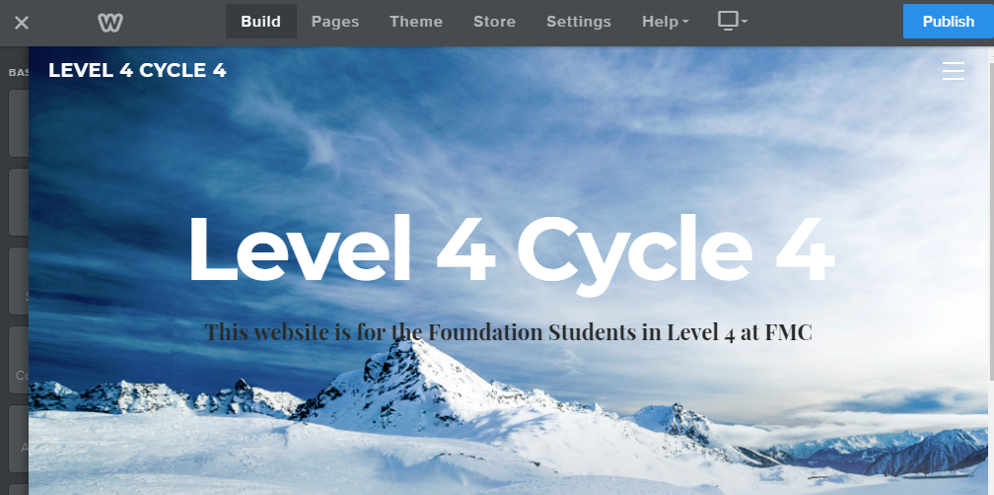

Slide 22
Add Images
03

Slide 23
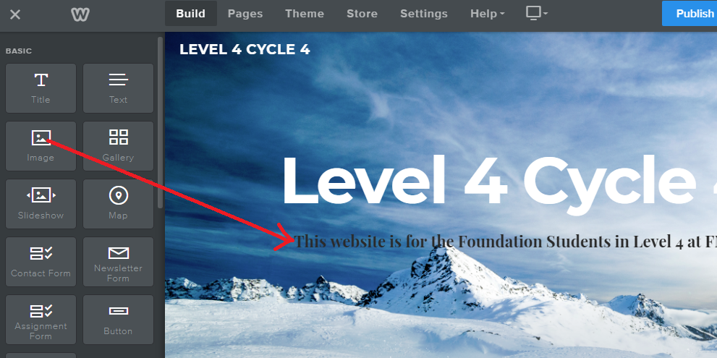
Drag the image tool to where you want it on the page
A blue line appears and indicates where the image will be placed as you move the mouse around the page

Slide 24
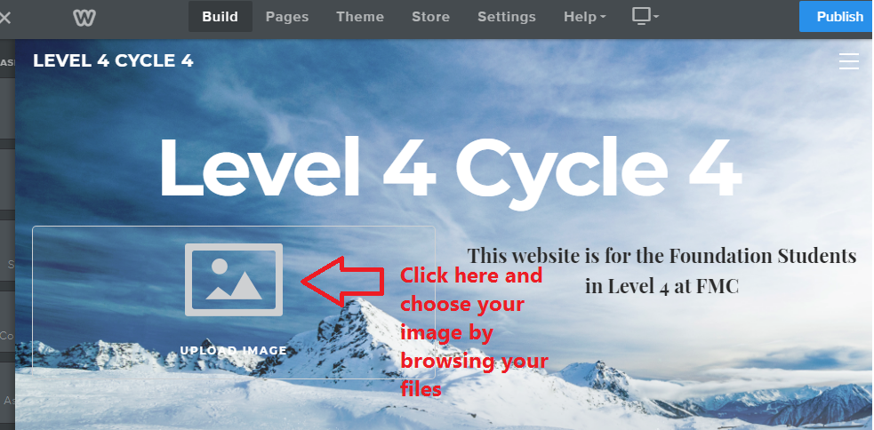
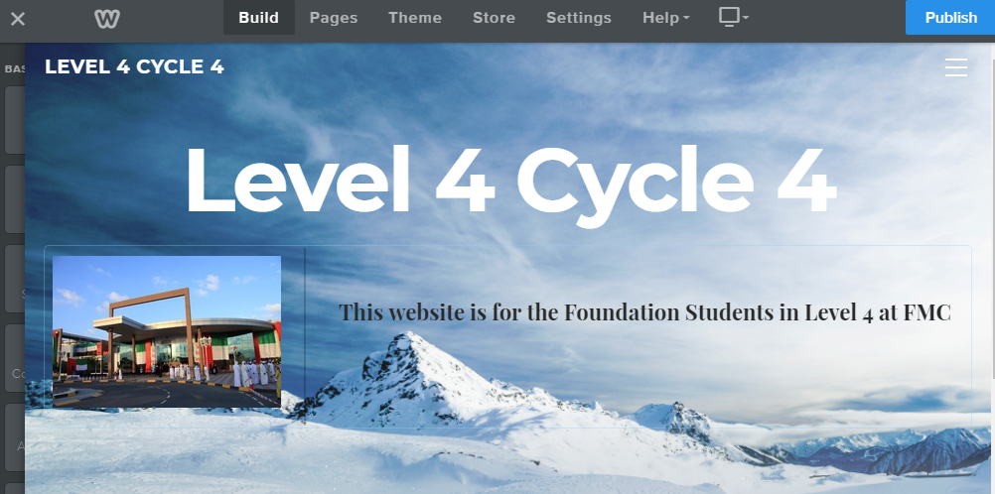
Click on the image icon and use the file browser to locate your image
Resize the image if needed!

Slide 25
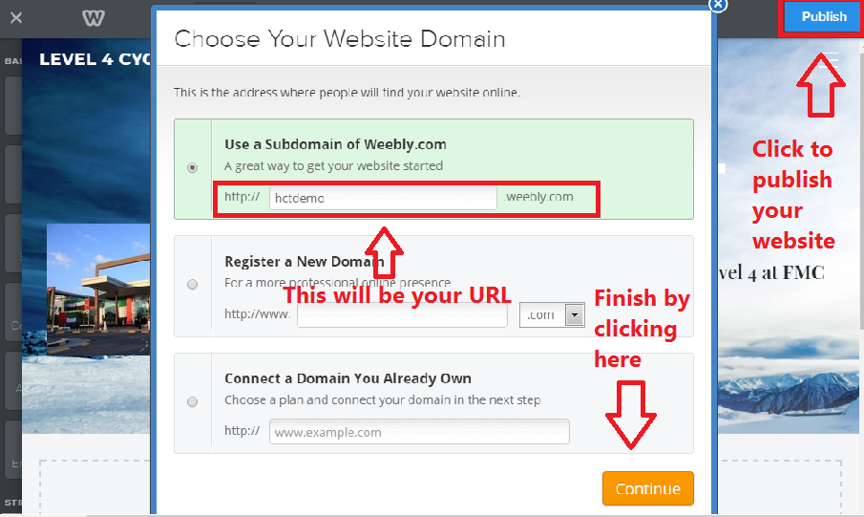
It’s time to publish your website!

Slide 26
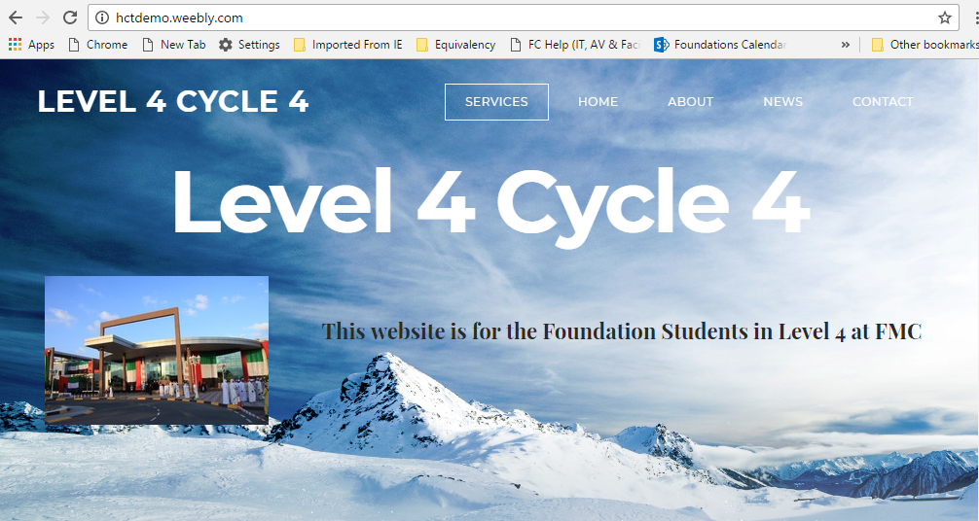
http://hctdemo.weebly.com/

Slide 27
Expand and Organise Your Page Structure
04

Slide 28
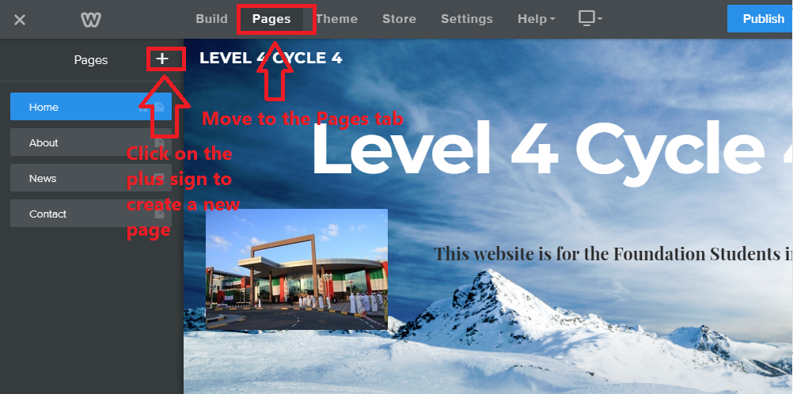
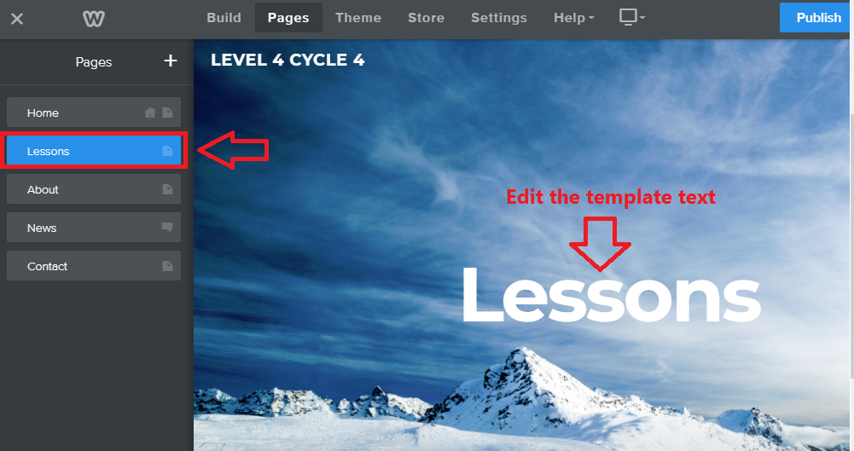
Adding Pages – New Main Page
Using the Pages tab, click on the + sign
Choose Standard Page
Call it Lessons
Click Done
Change the template page title to Lessons
Move it up in the pages list and put it under your Home page

Slide 29
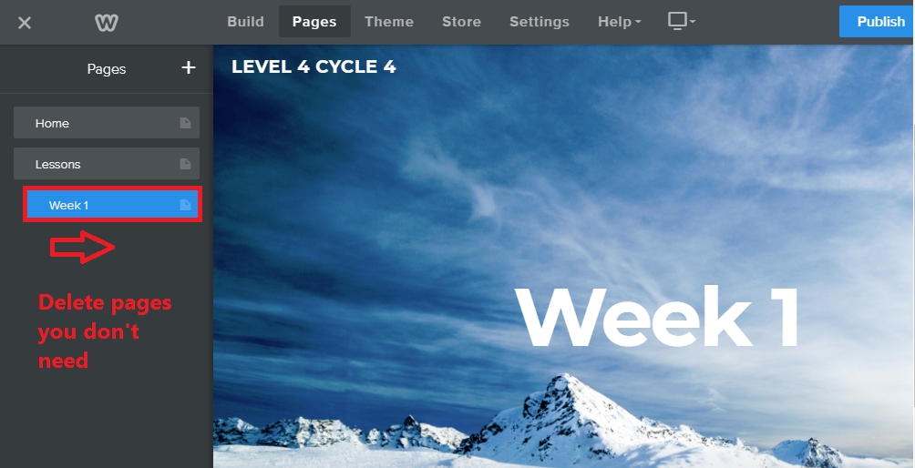
Adding Pages – New Subpage
Using the Pages tab, click on the + sign
Choose Standard Page
Call it Week 1
Click Done
Change the template page title to Week 1
Move it up in the pages list and put it under your Lessons page
Pull it slightly to the right to make it a subpage

Slide 30
You now have two main pages and one subpage

Slide 31
Build Your Own Template Page and Duplicate It
05

Slide 32
Minimise the header image for your template page
Drag the point upwards with your mouse

Slide 33
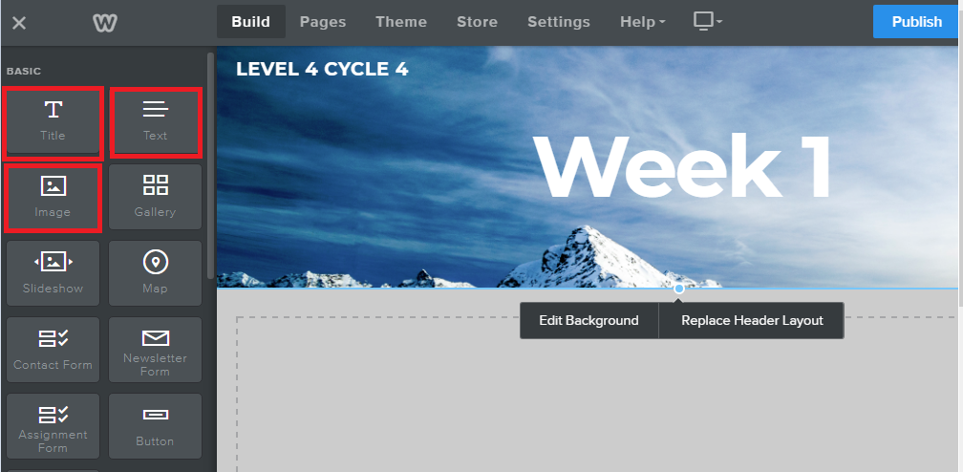
Populate your template page
Use the Title, Text and Image tools to populate your template page

Slide 34
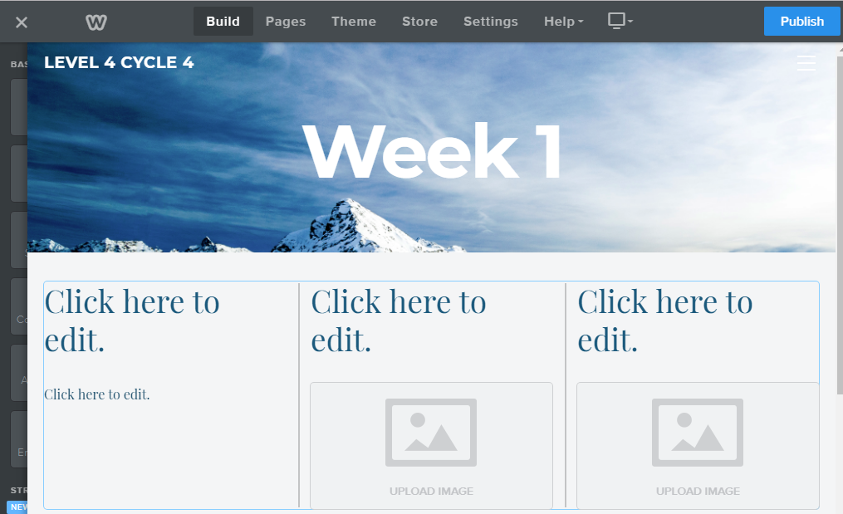
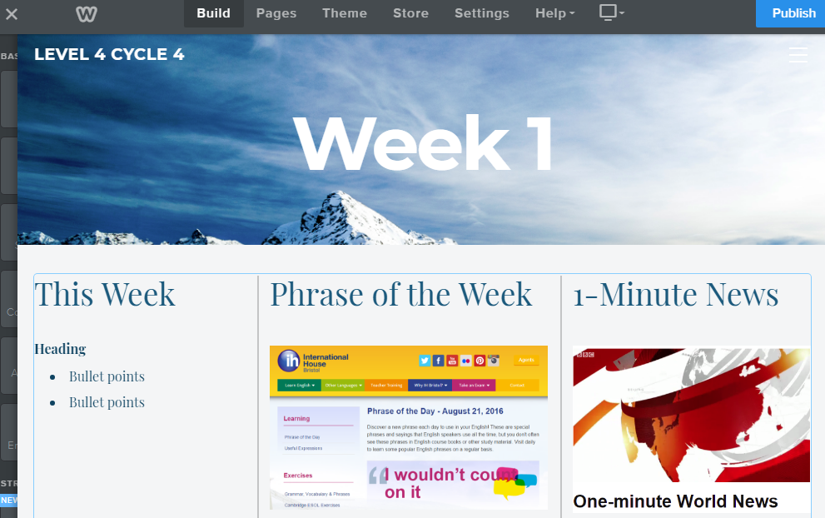
Example of a weekly template – Main section
Weekly focus point at the top

Slide 35
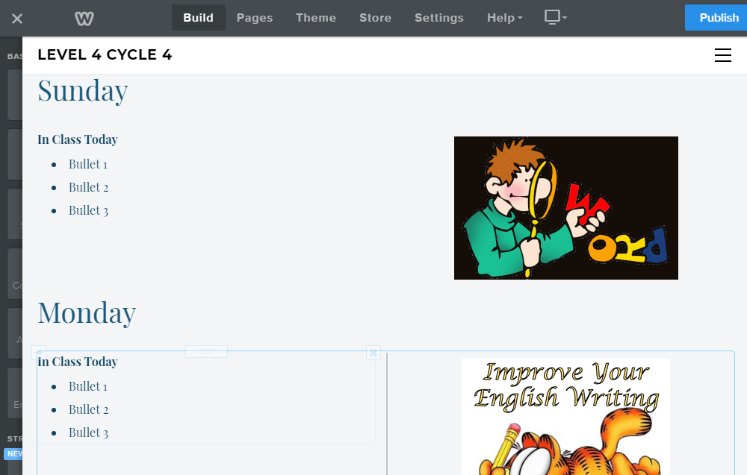
Example of a weekly template – Daily sections
Daily sections below

Slide 36
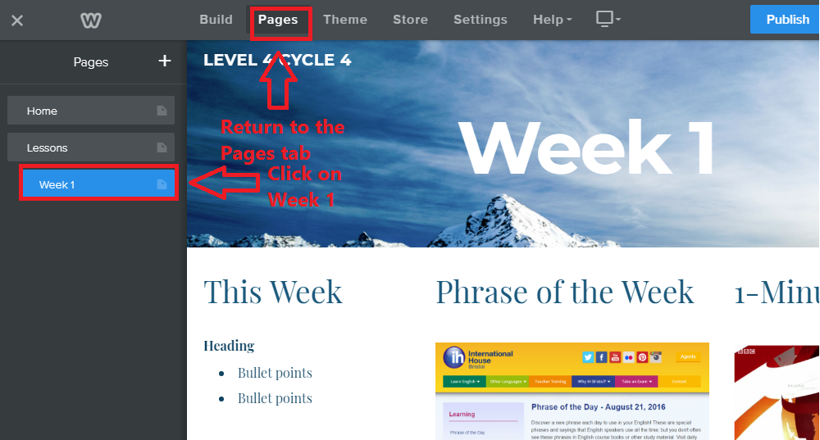
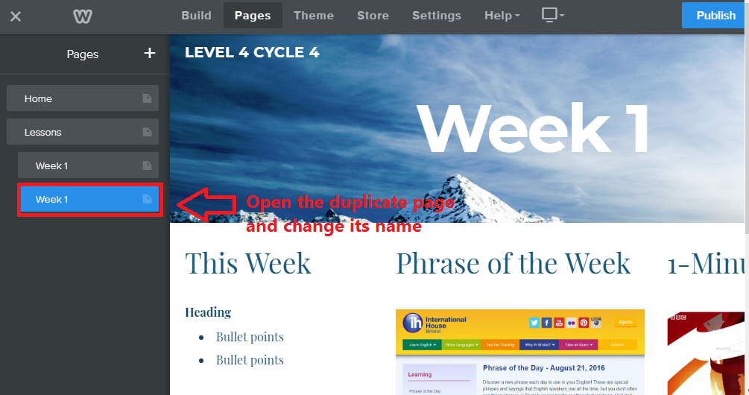
Duplicating a template page
In Pages mode, select your template page
Click on Copy
Open your duplicate page and change its name
Repeat this for as many duplicate pages as you need

Slide 37
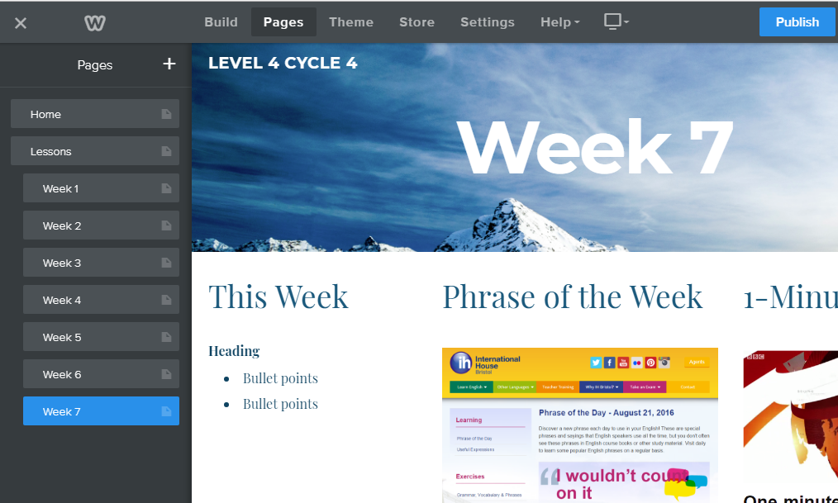
Main pages + subpages = increase website navigation

Slide 38
Your website navigation

Slide 39
Add Files & Links
06

Slide 40
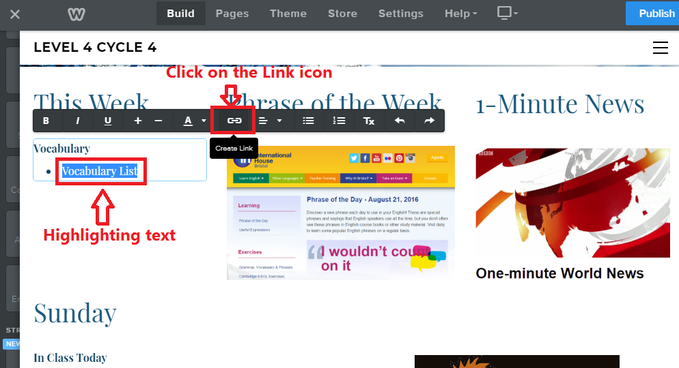
Adding Files Highlight any text or image and click on the Link icon

Slide 41
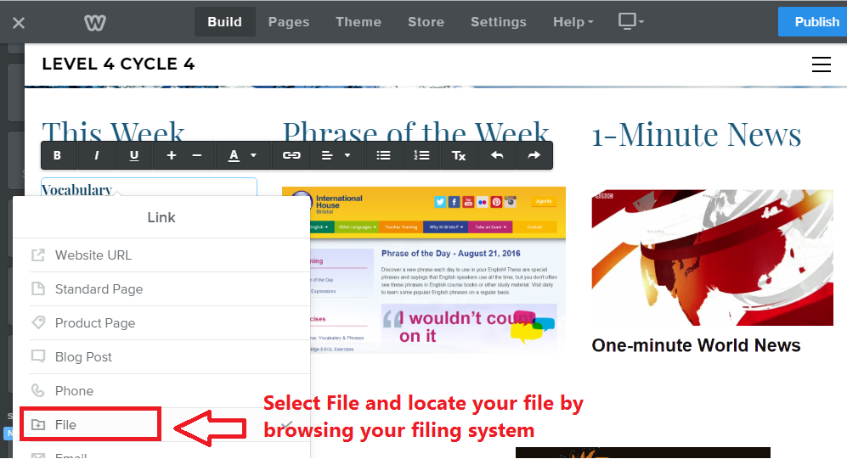
Select the File option and upload your file

Slide 42
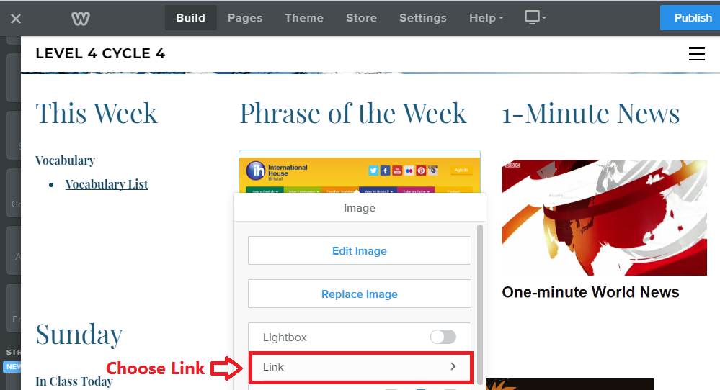
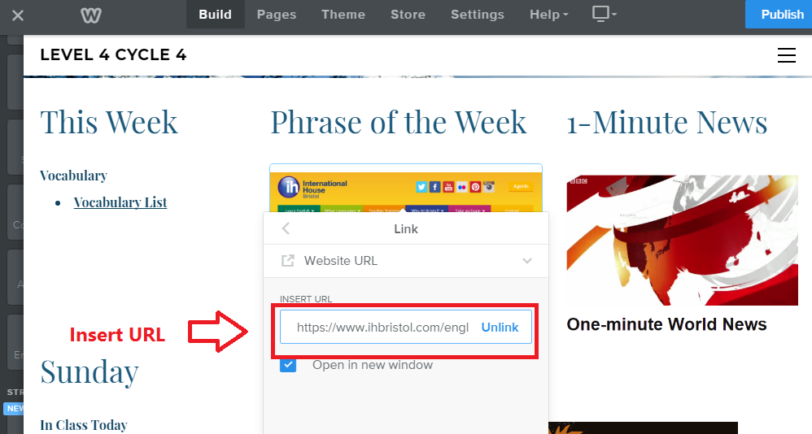
Add Links Highlight any text or image and click on the Link icon
Select the Website URL option
Insert your URL in the URL field

Slide 43
Congratulations!
You now have a teaching website with:
a Home page
a new menu option (Lessons)
a number of submenus (Weeks)
You have
Added text
Added images
Added links
Added files

Slide 44
YouTube Videos & Picture Galleries
07

Slide 45
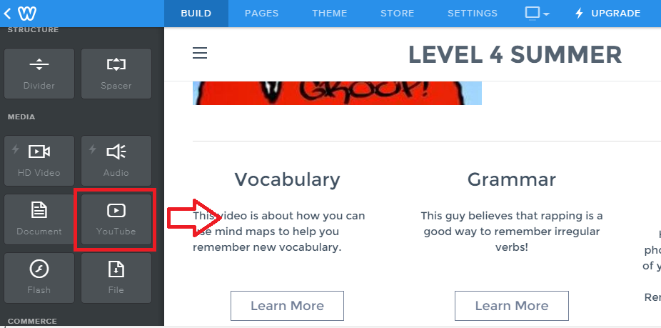
YouTube Videos – Drag the YouTube icon onto your page

Slide 46
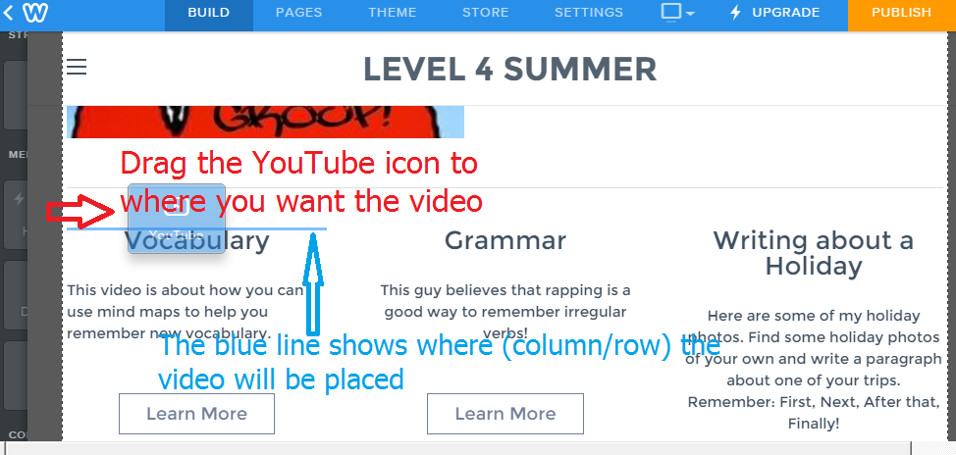
Place the YouTube icon where you want the video to show

Slide 47
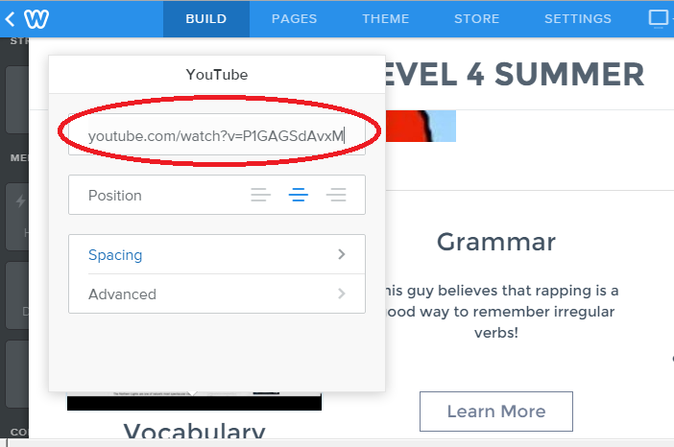
Click on the YouTube template image and add the URL for your video

Slide 48
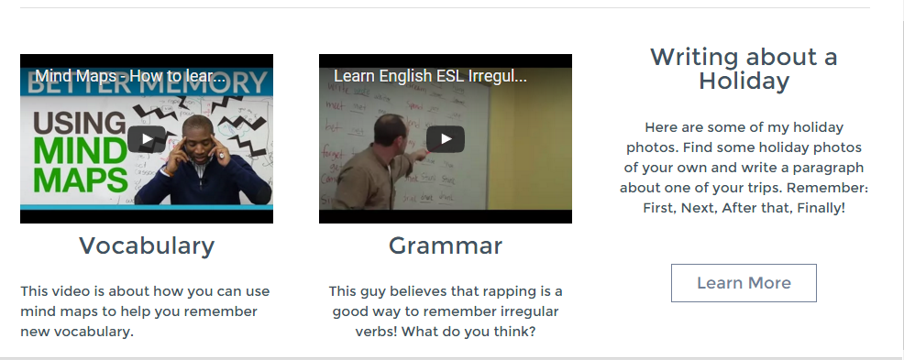
Your students can now watch the videos you have selected directly from the webpage.

Slide 49
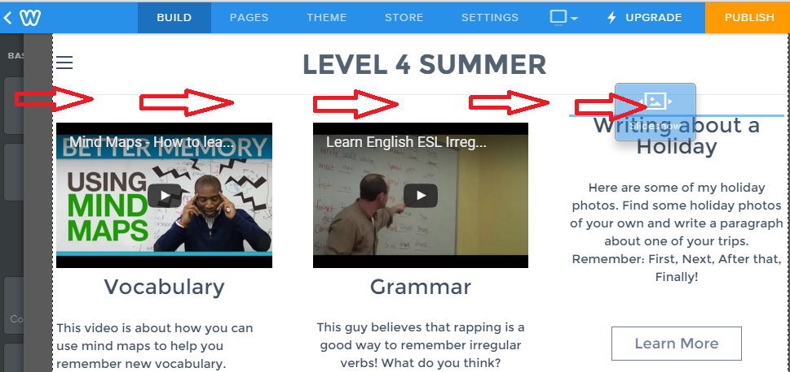
Slide Show – Drag the Slide Show icon onto your page

Slide 50
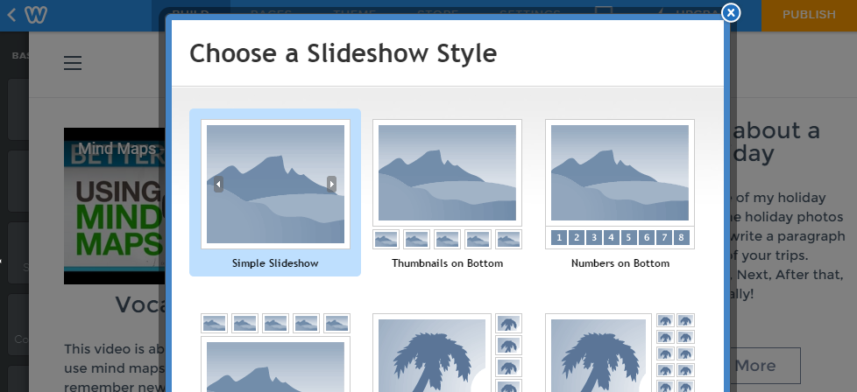
Select the Slideshow style you want

Slide 51
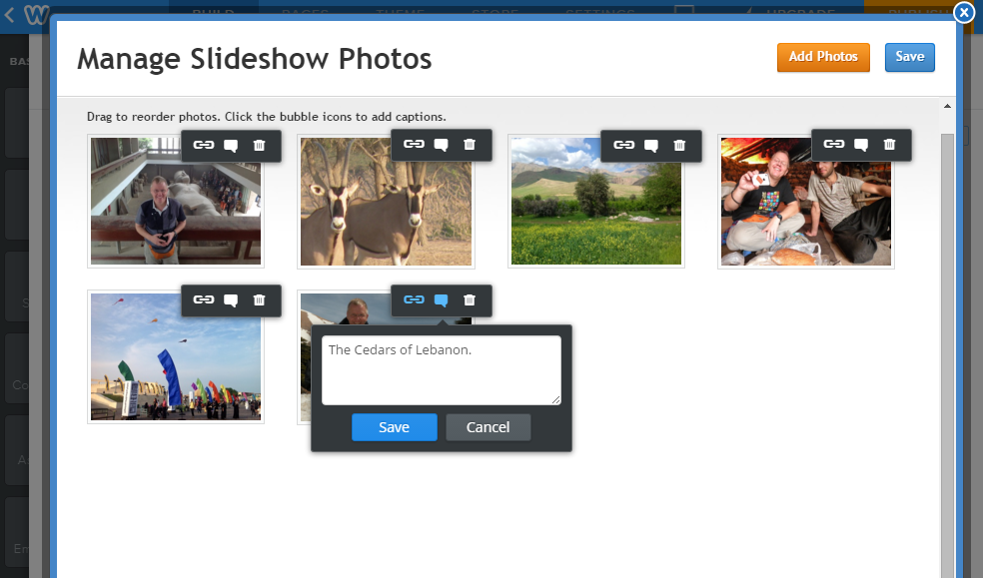
Add Captions & Links to your Slideshow

Slide 52
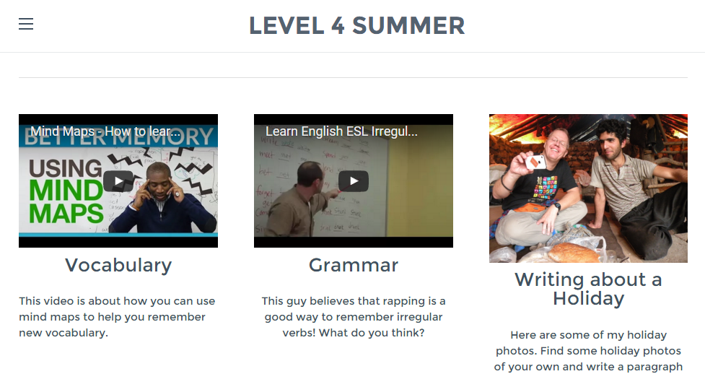
Videos and Slideshows are ready to go!
Similar web page
can be found here

Slide 53
Layout Issues
08

Slide 54
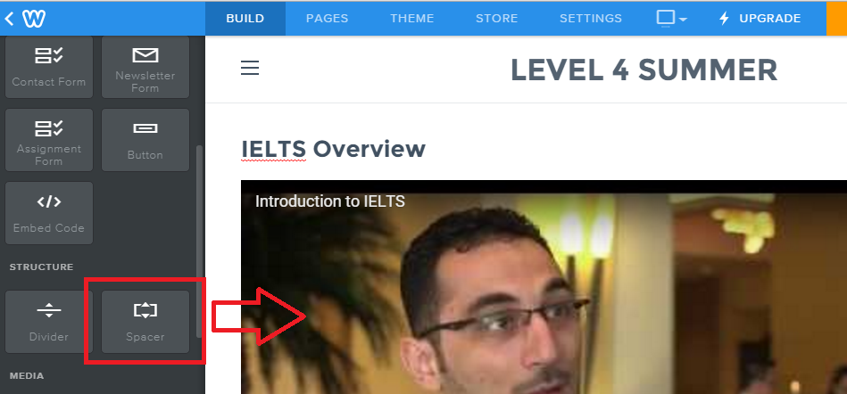
Using the Spacer to resize elements

Slide 55
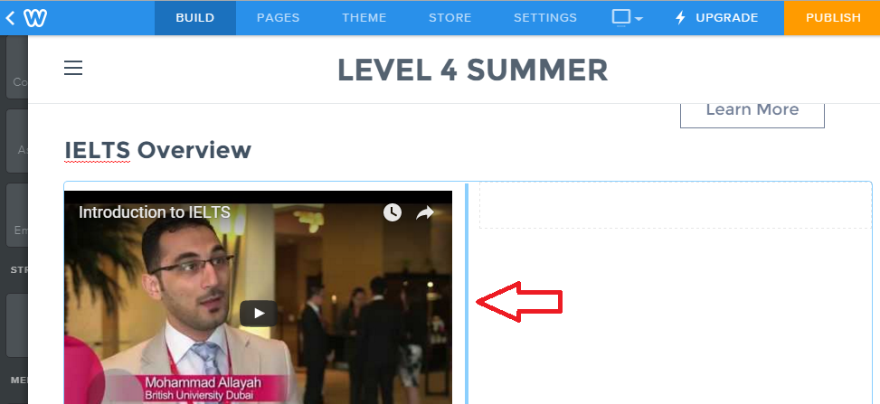
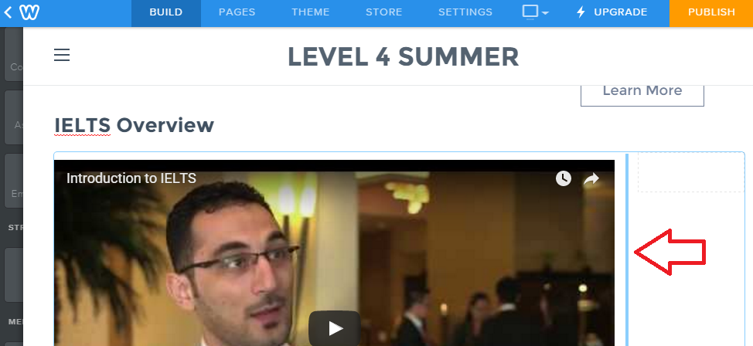
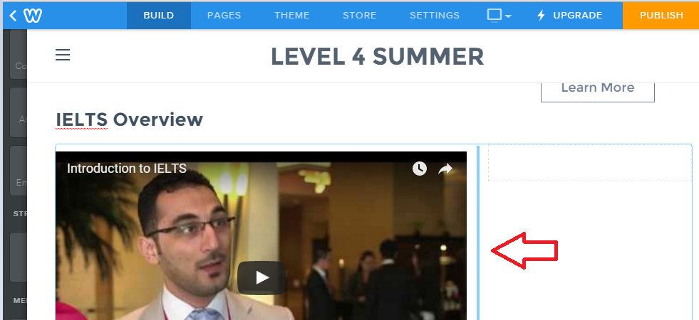
Drag the Spacer line to resize your element (spacer = creates empty space)

Slide 56
Collecting Assignments & Projects
09

Slide 57
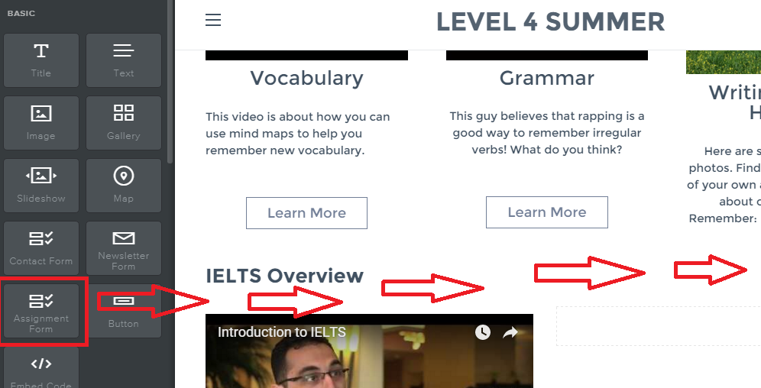
Use the Assignment Form icon to collect student work

Slide 58
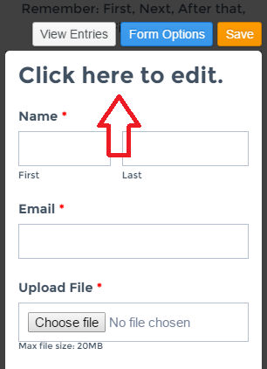
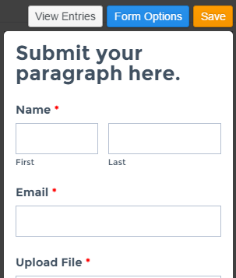
Edit the Assignment Form to suit your needs

Slide 59
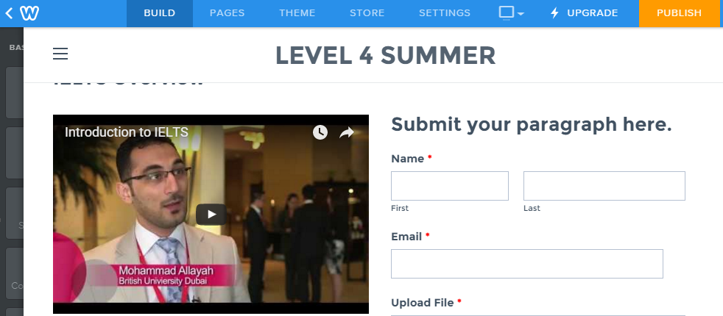
Students can submit files up to 20 MB (PC and iPad)

Slide 60
Set Up Websites for Your Students!
10

Slide 61
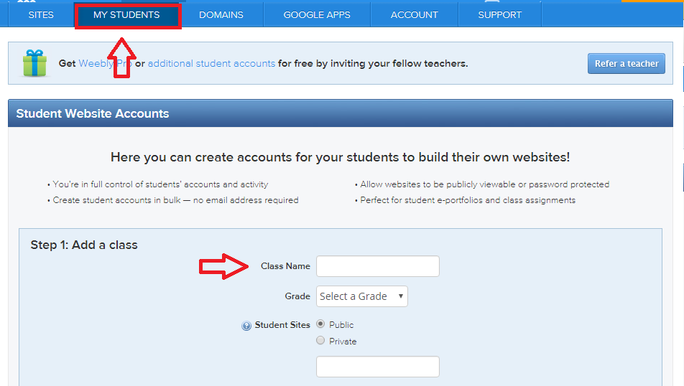
First, click on My Students tab to create a class

Slide 62
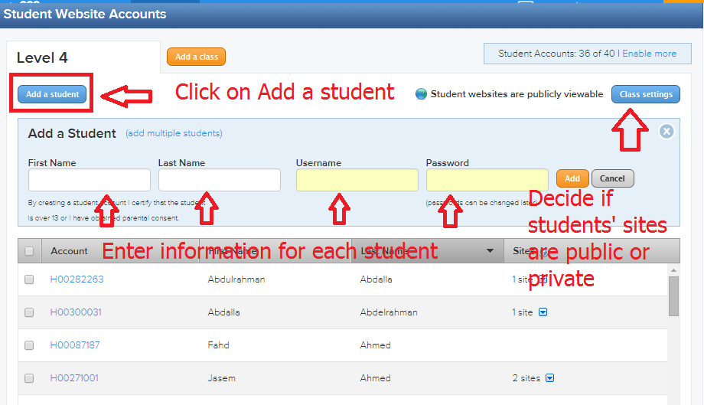
Next, add students and decide if sites are public or private (no email needed)

Slide 63
Finally, print usernames & passwords for your record

Slide 64
Questions?

Slide 65
bjorn.candel@hct.ac.ae

