Slide 1
Six things students are learning while playing with their phones in class
Bjorn Candel
Fujairah Men’s College

Slide 2
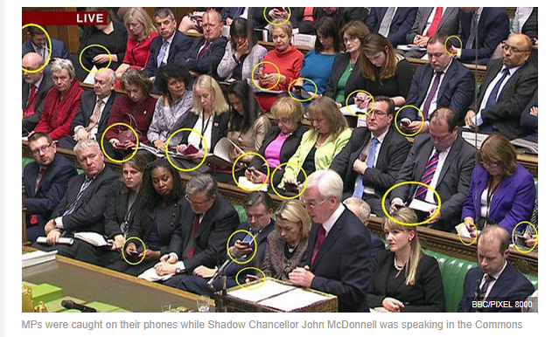
Notes:
https://www.express.co.uk/comment/expresscomment/736267/MPs-mobile-phones-texting-John-McDonnell

Slide 3
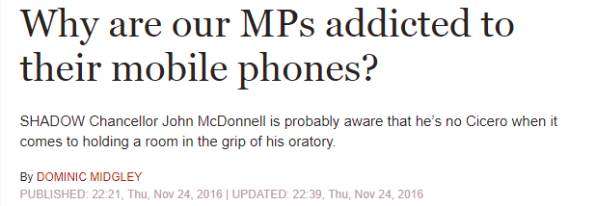
How would you frame it?

Slide 4
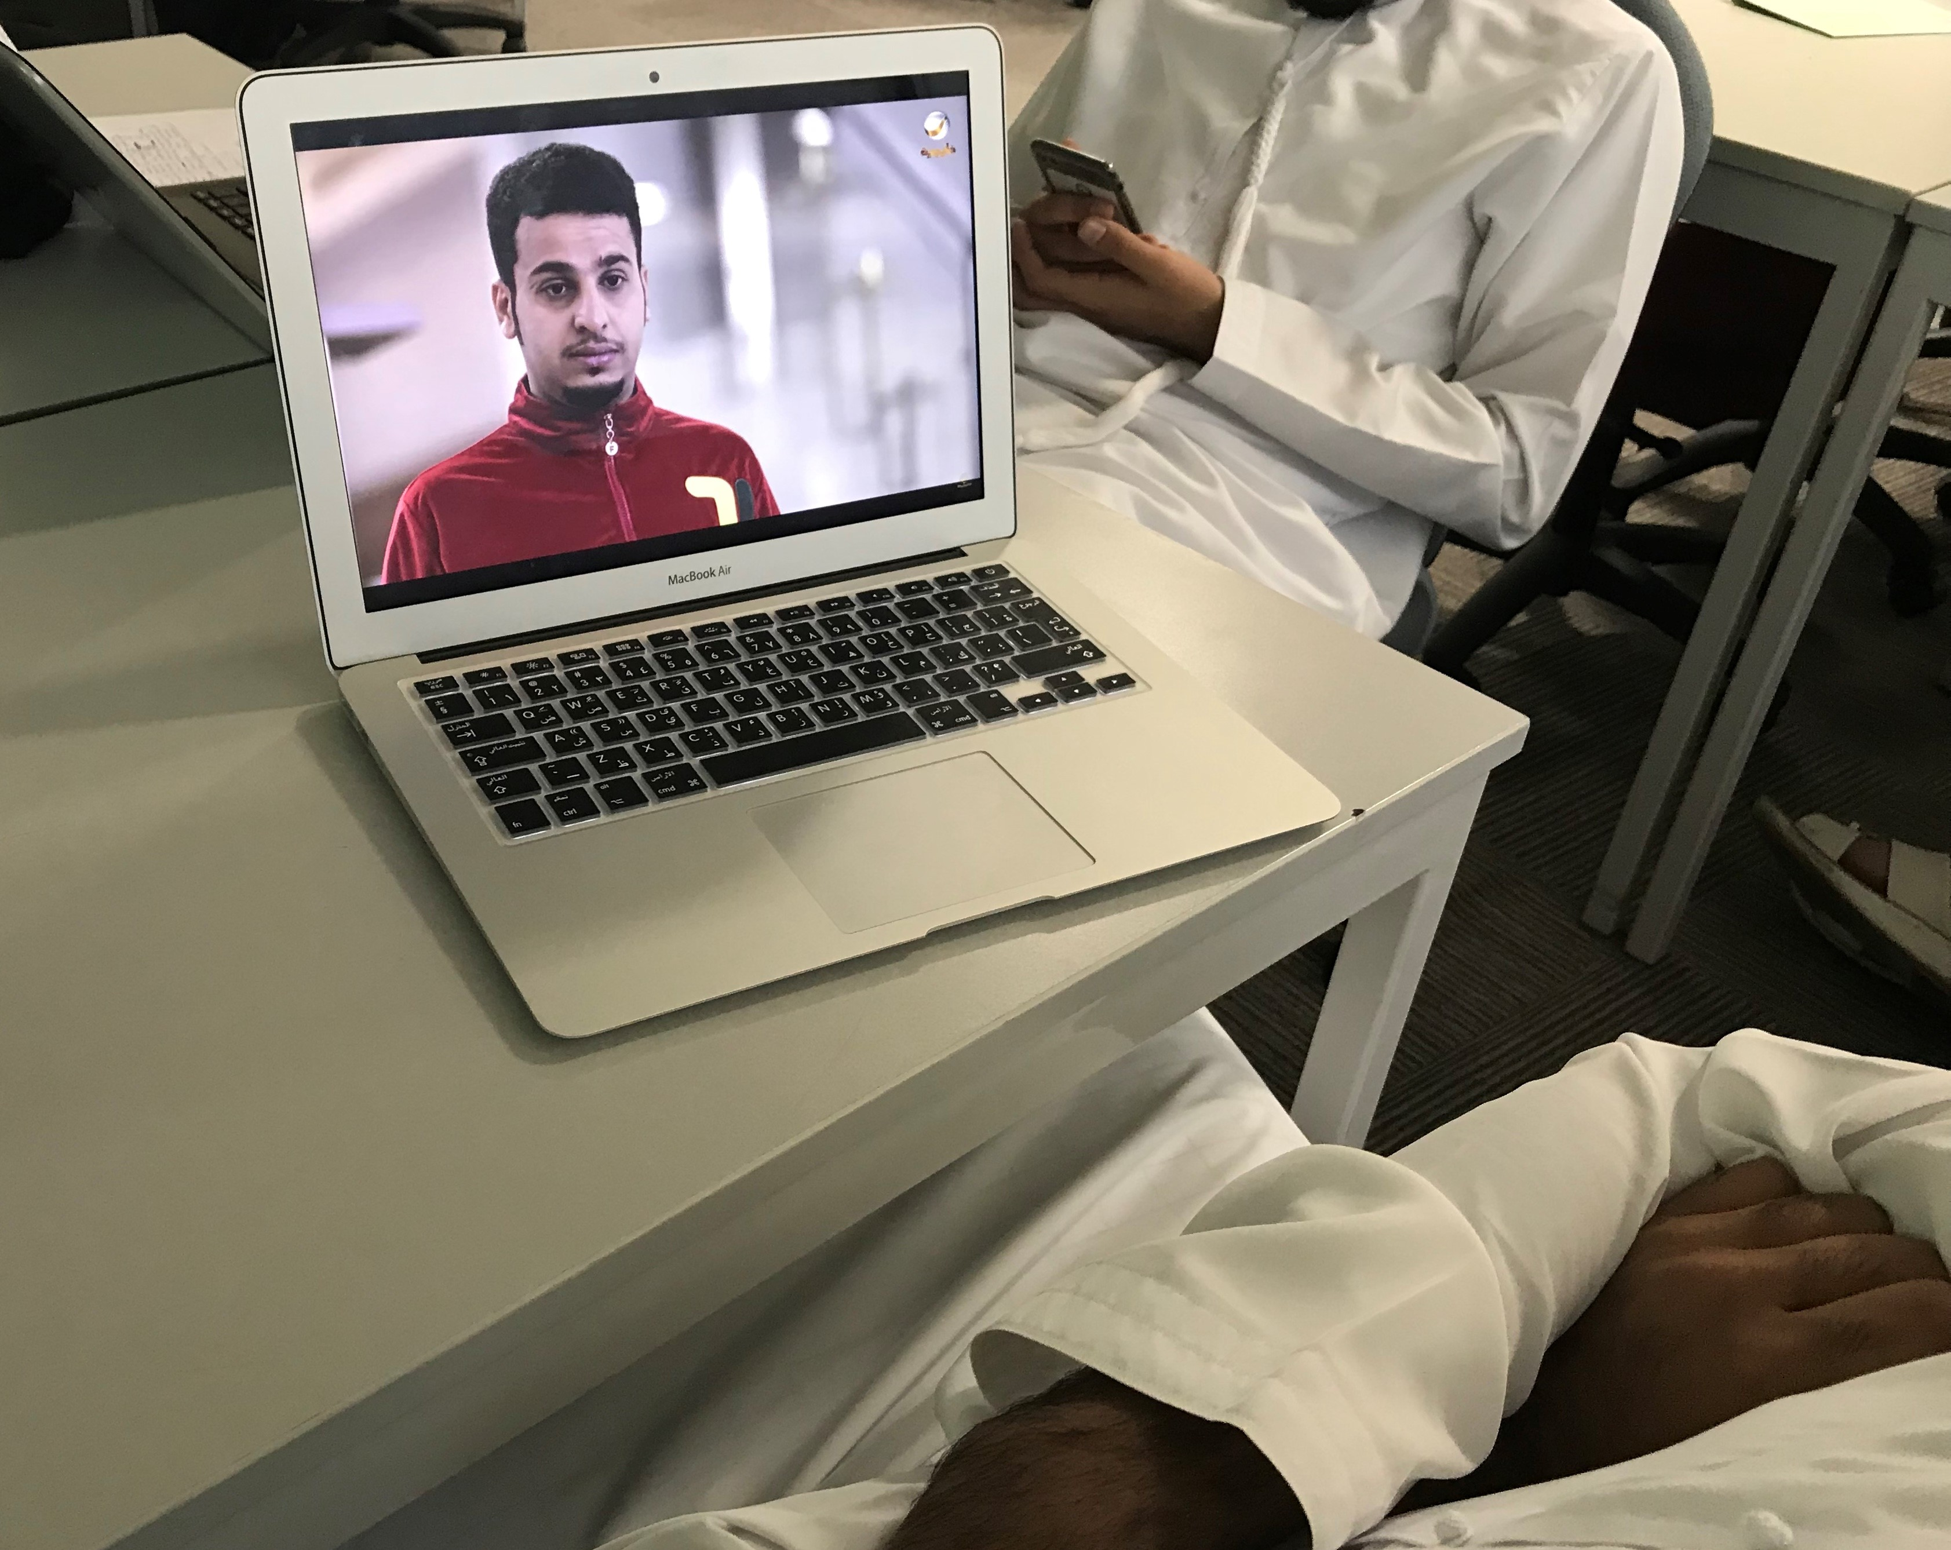
1. Critical Thinking

Slide 5
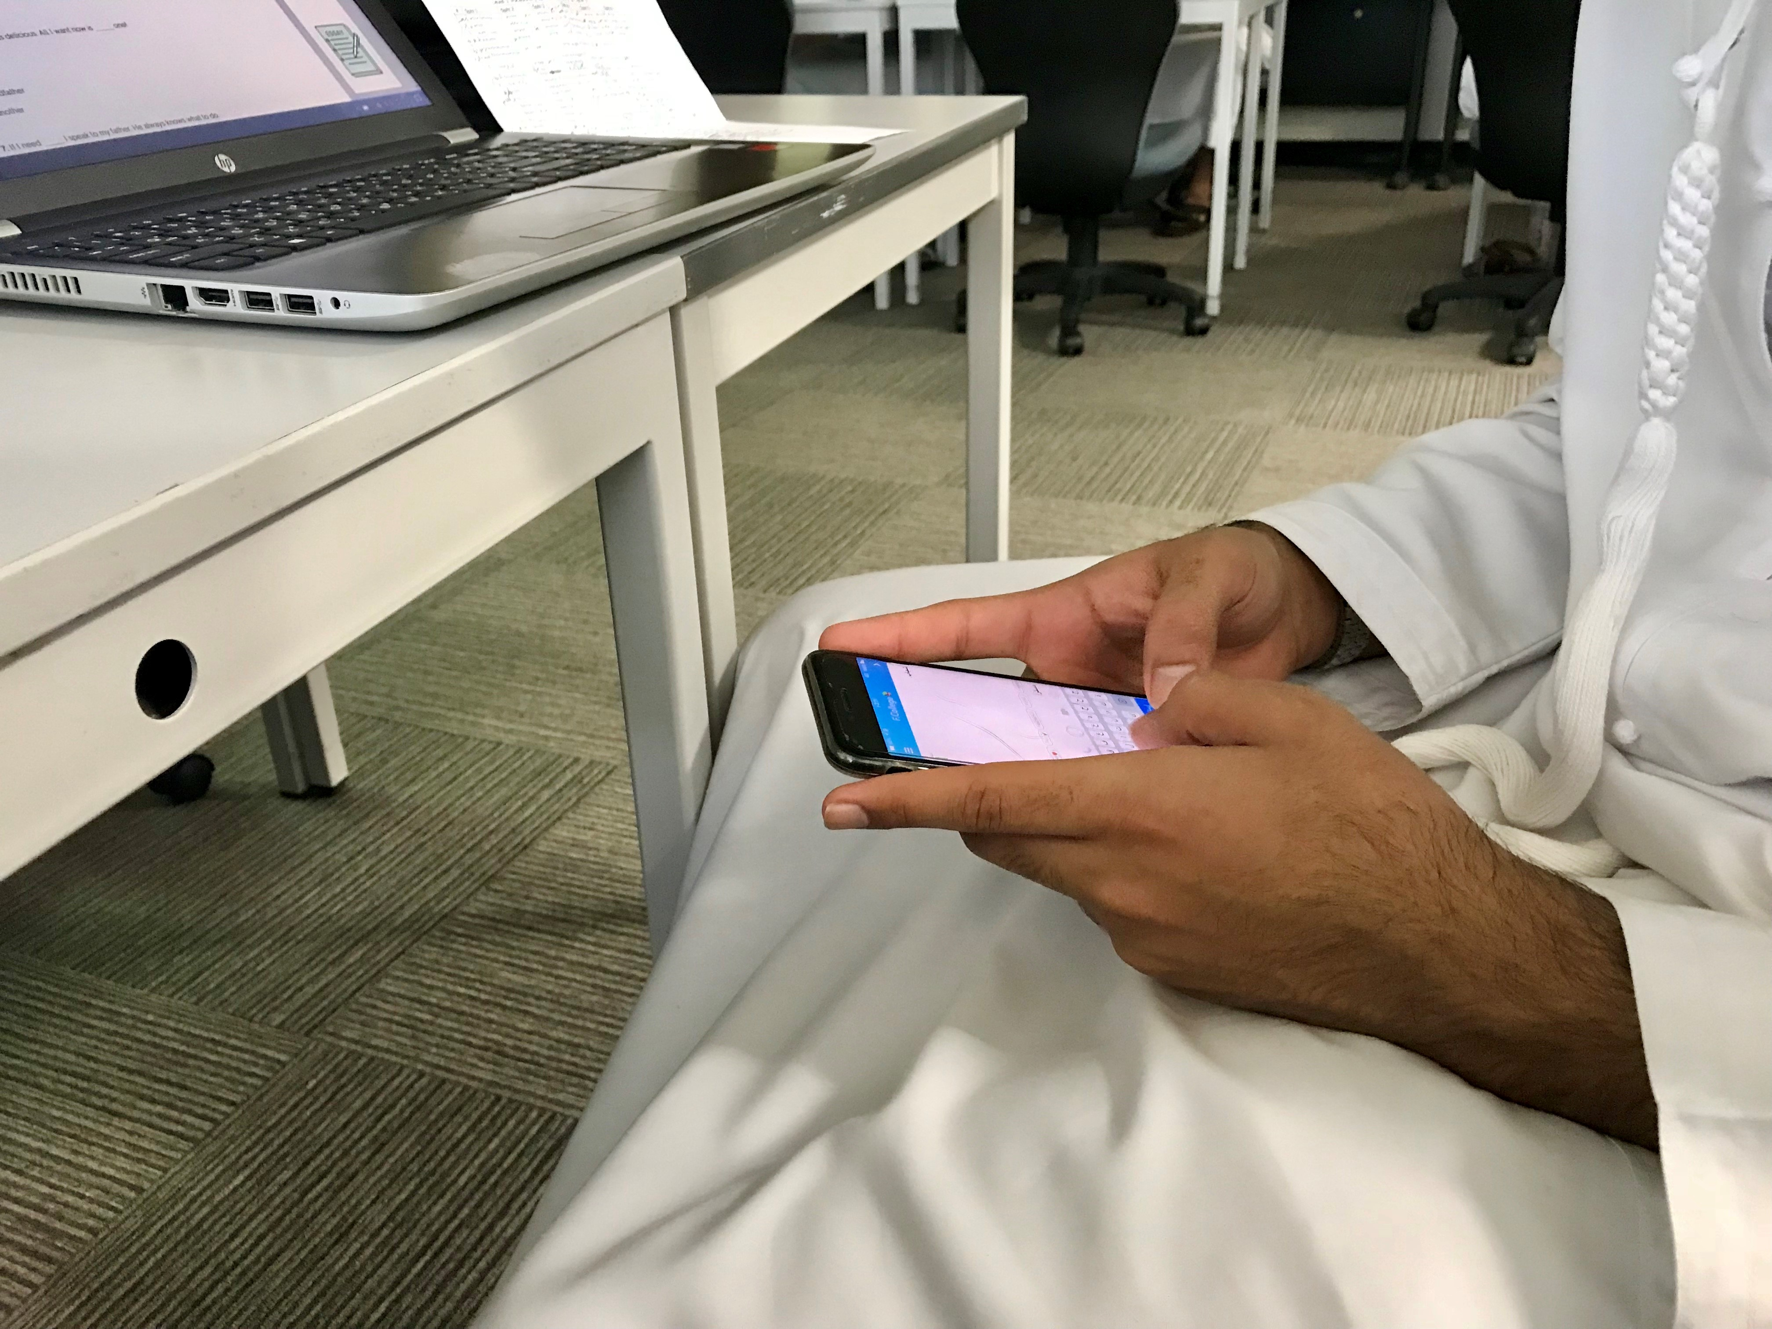
2. Communication

Slide 6
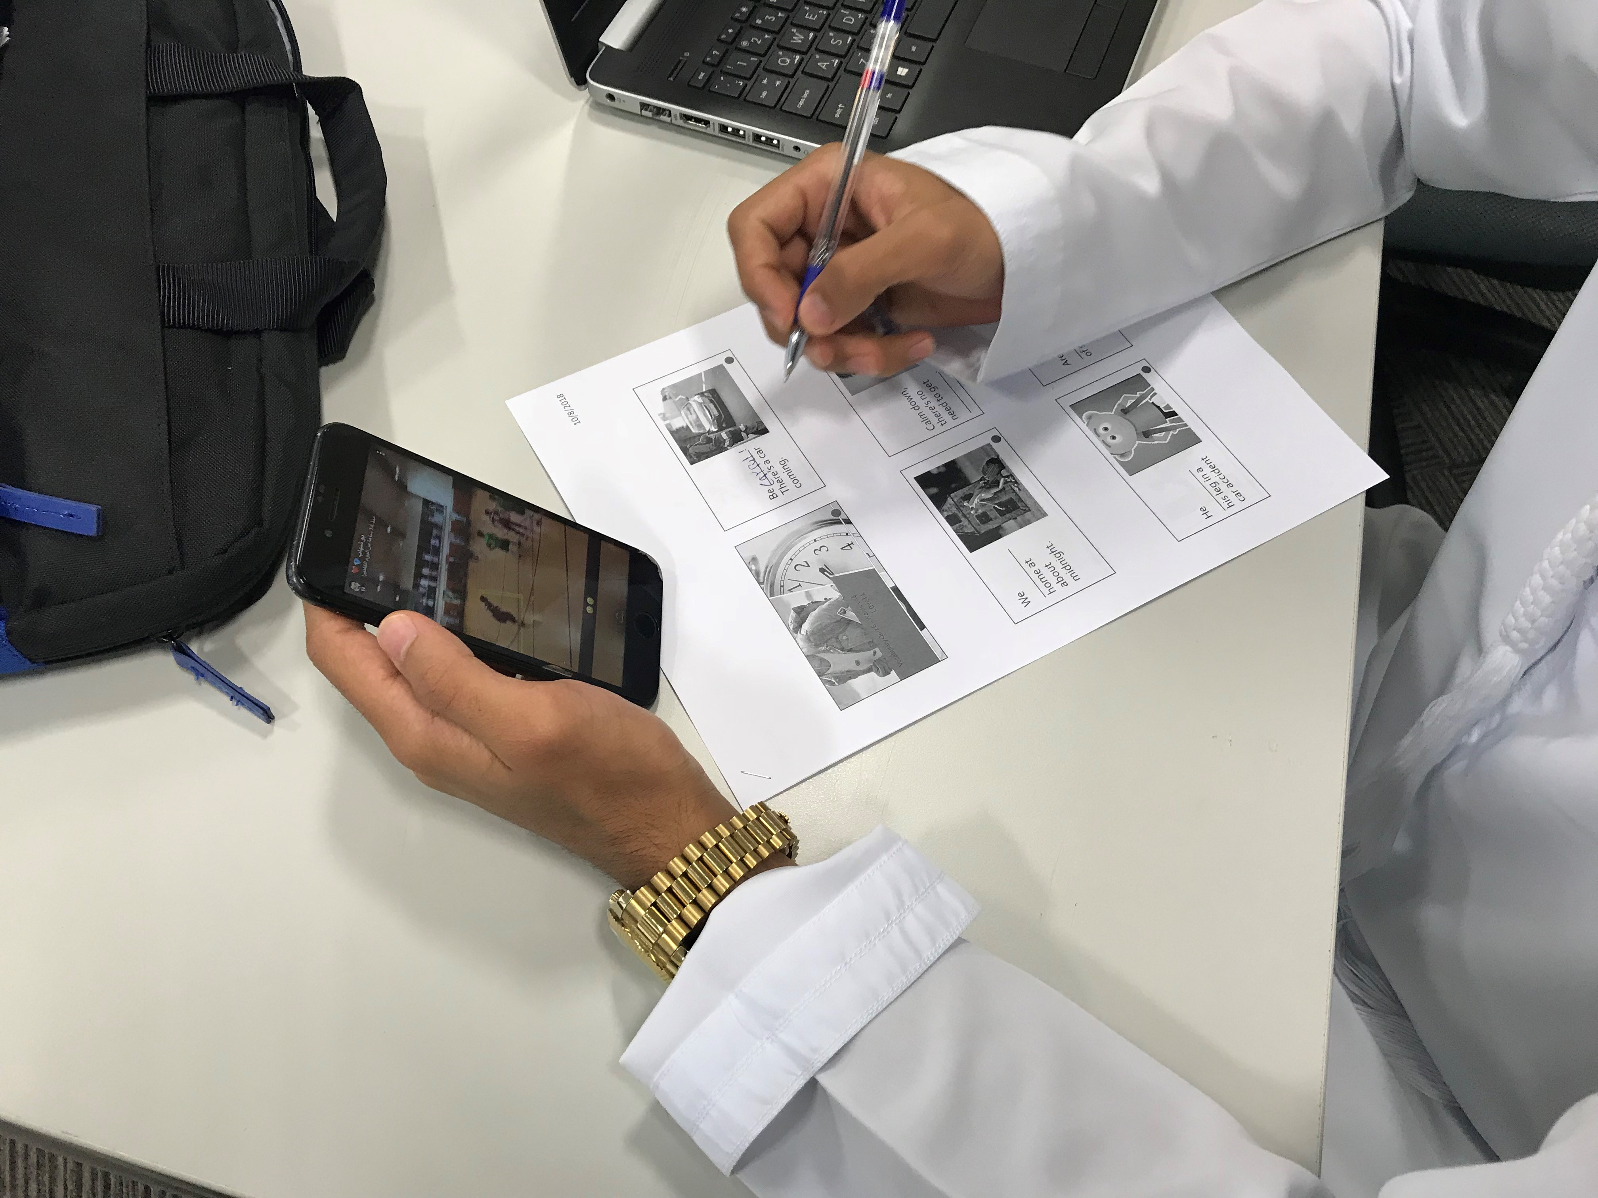
3. Media Literacy
& Multi-Tasking

Slide 8
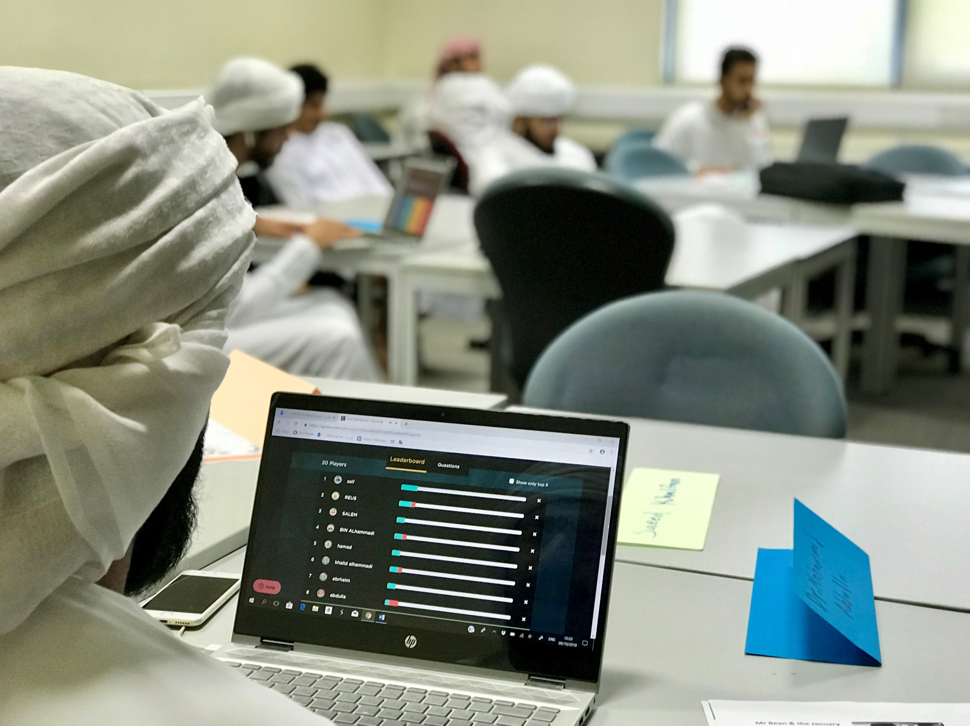
Media Literacy &
IT Literacy

Slide 9
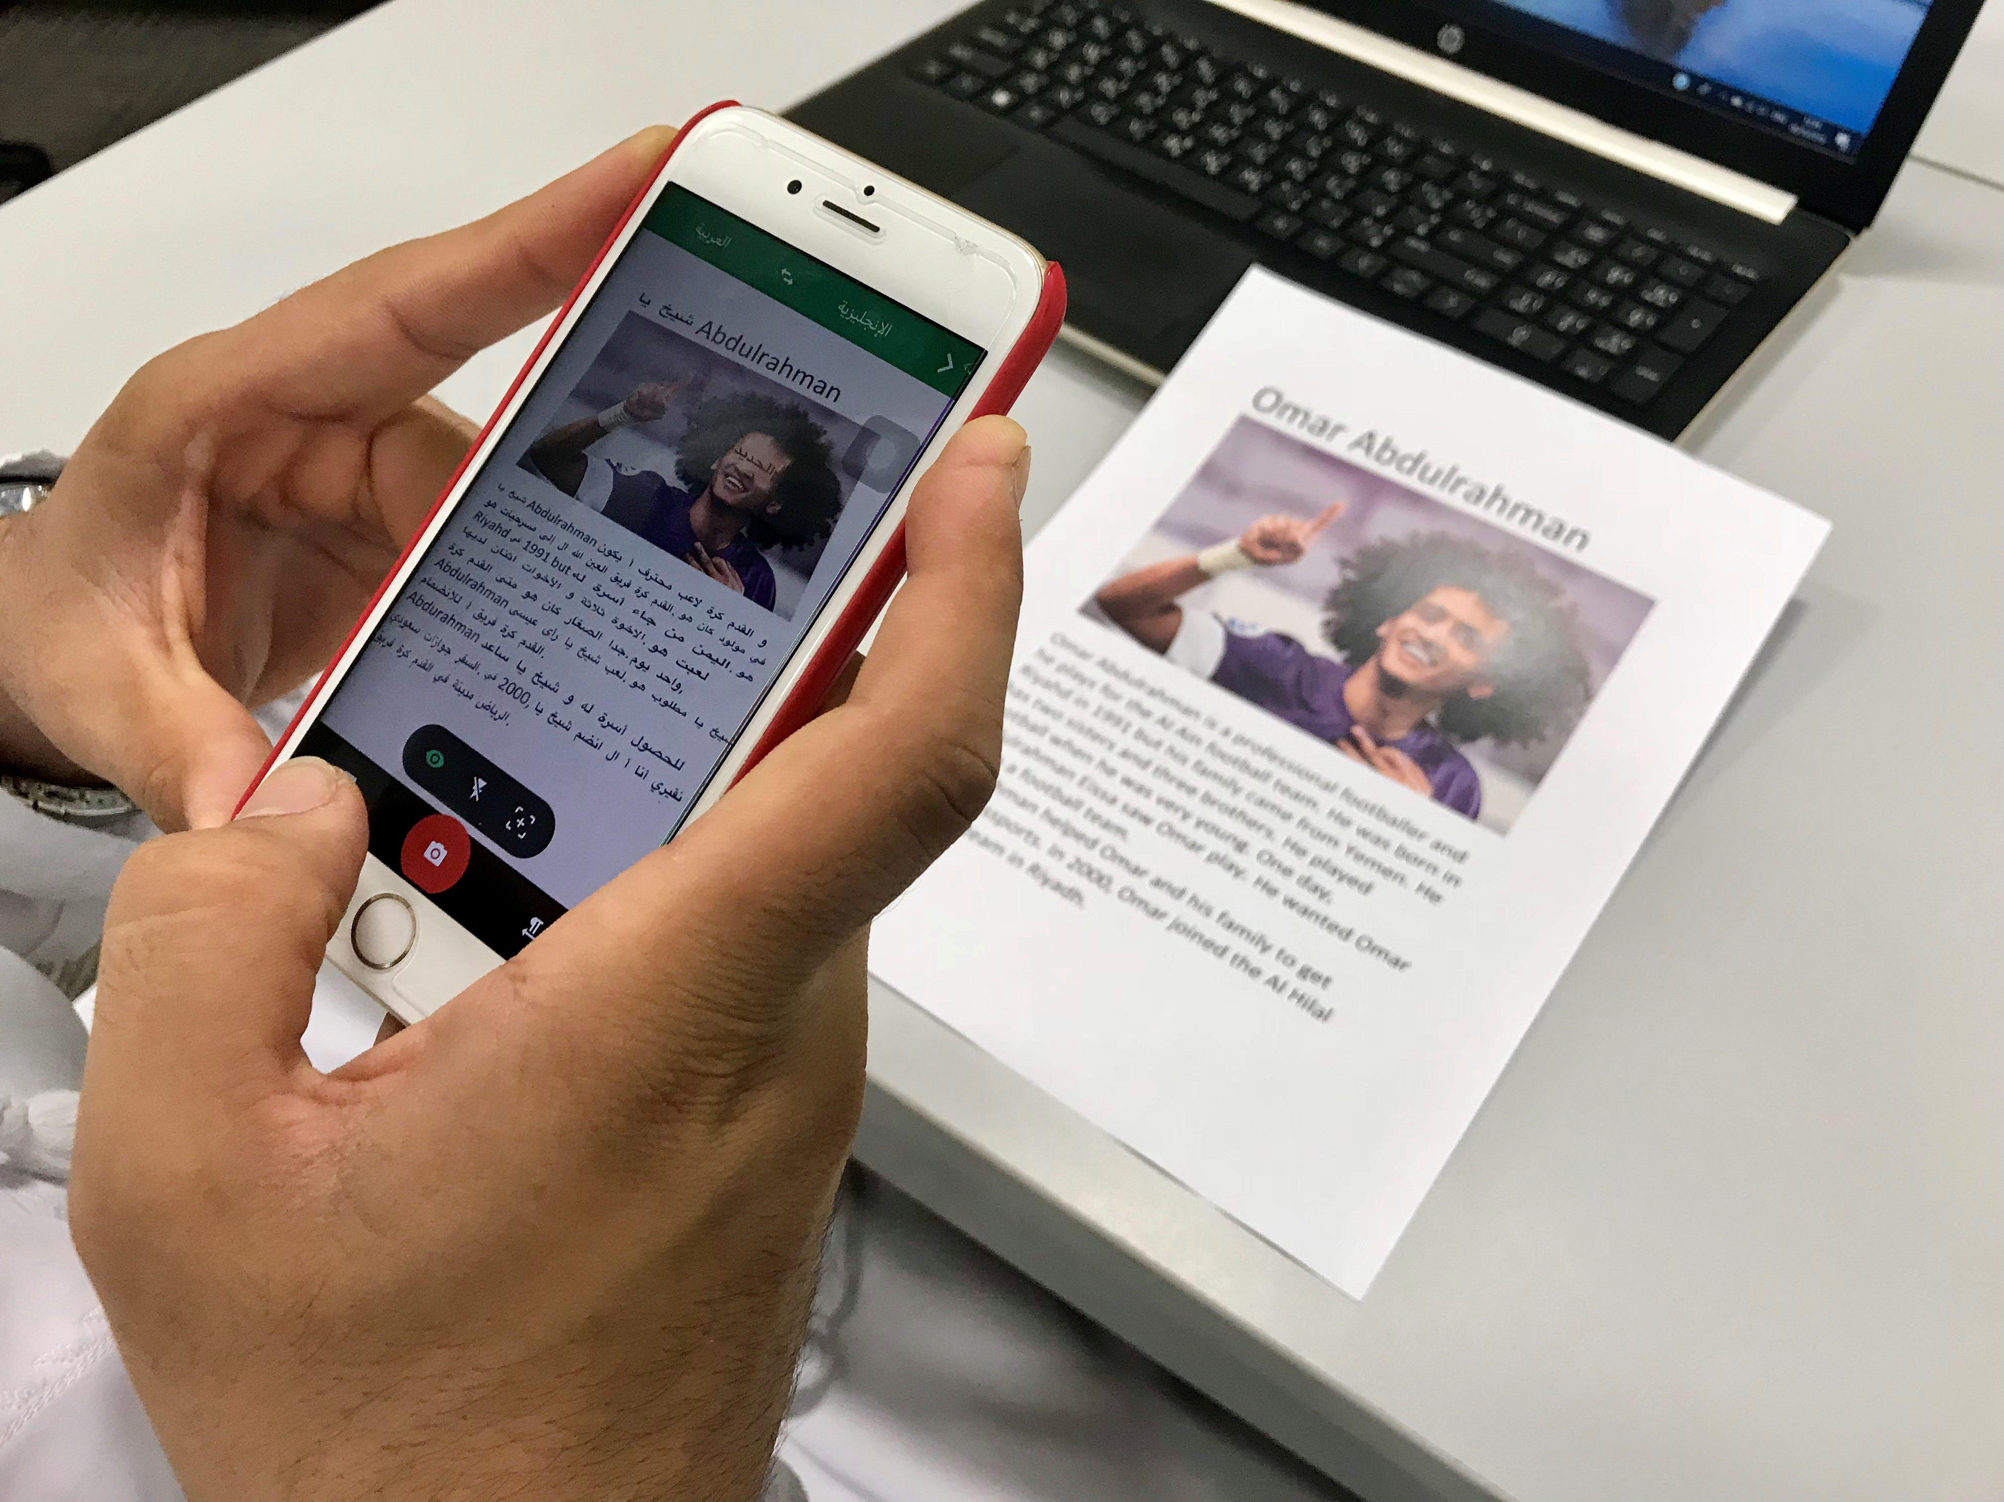
4.Problem
Solving

Slide 10
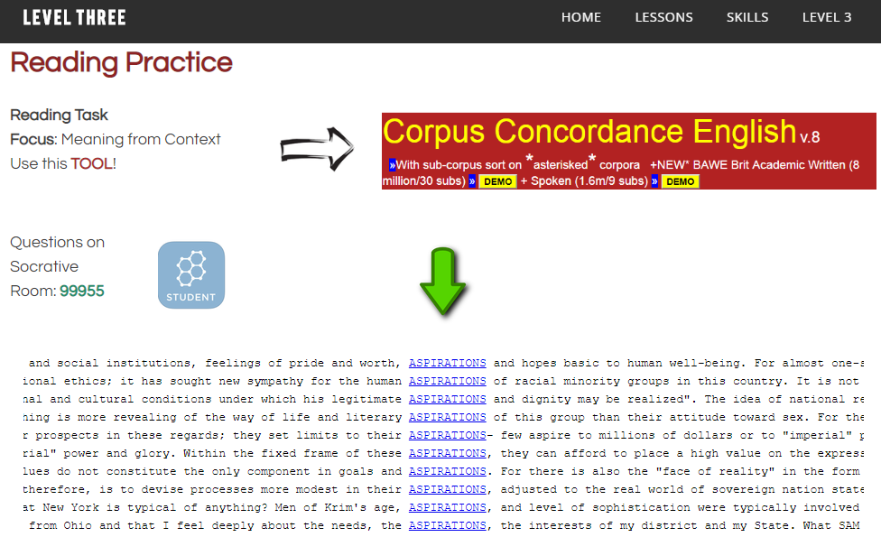

Slide 11
Free Concordancer / KWIC
https://www.lextutor.ca/conc/eng/

Slide 12
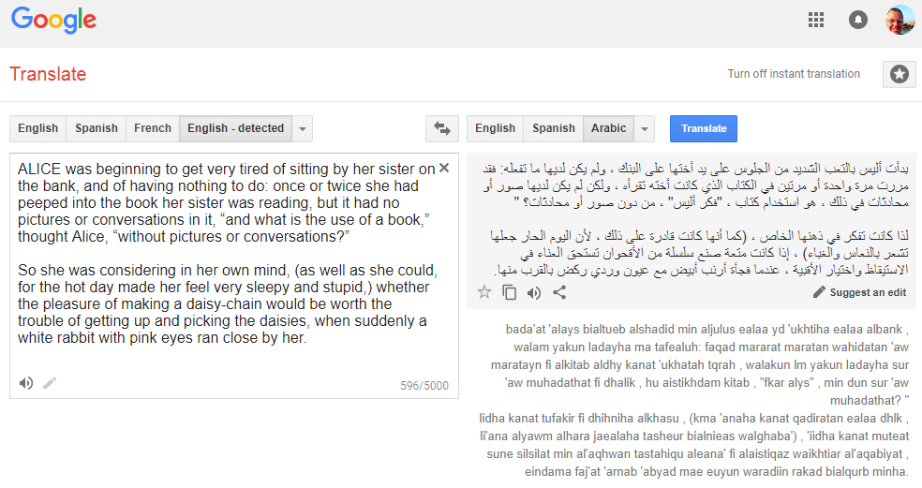
5. Creativity

Slide 13
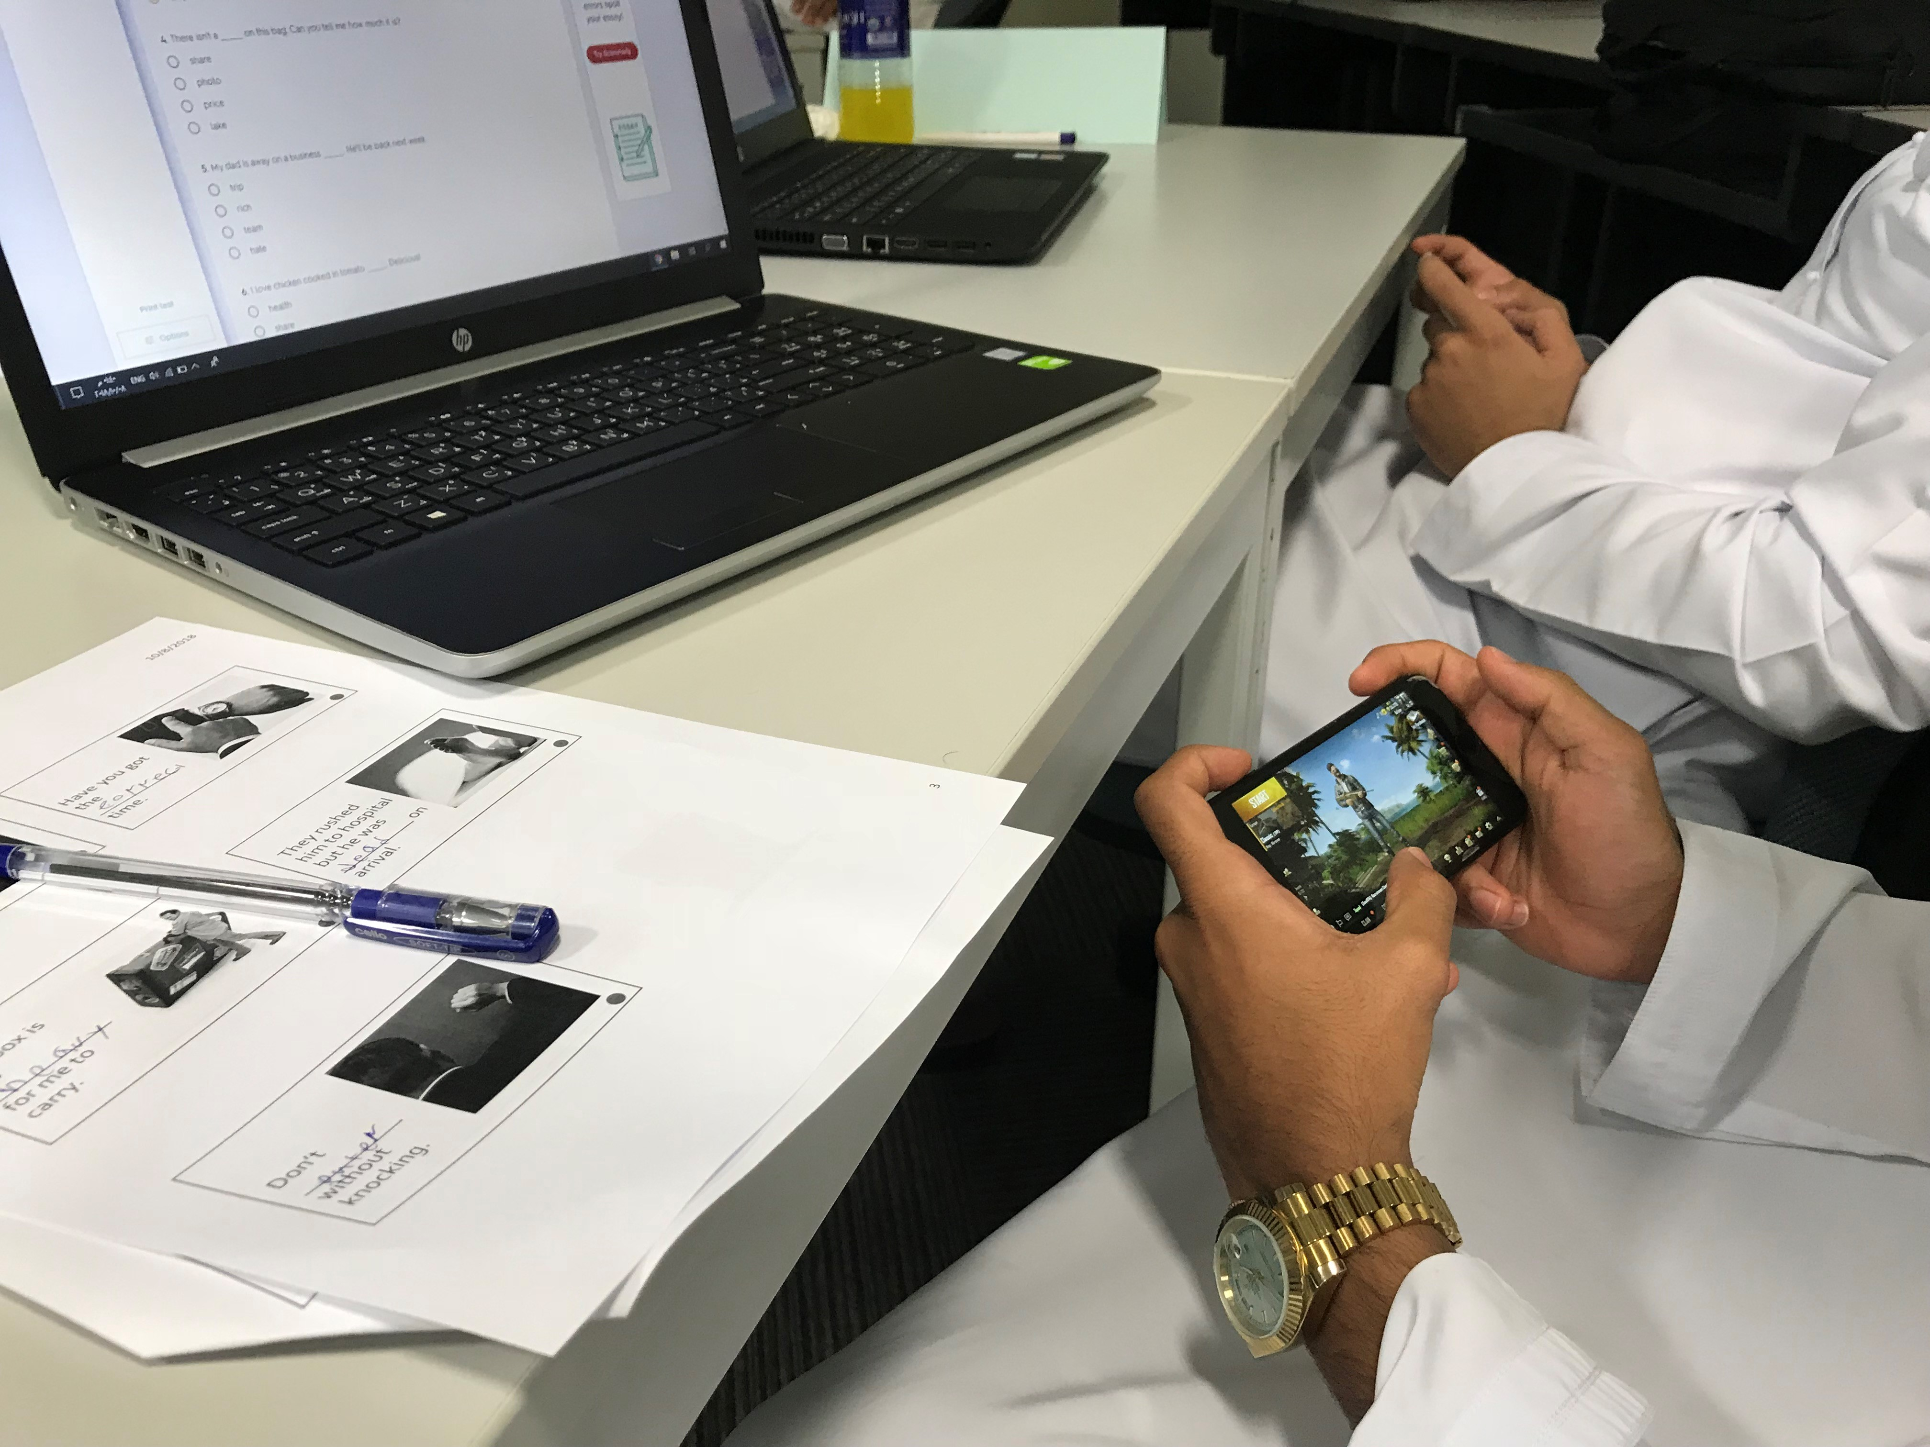
6. Collaboration

Slide 14
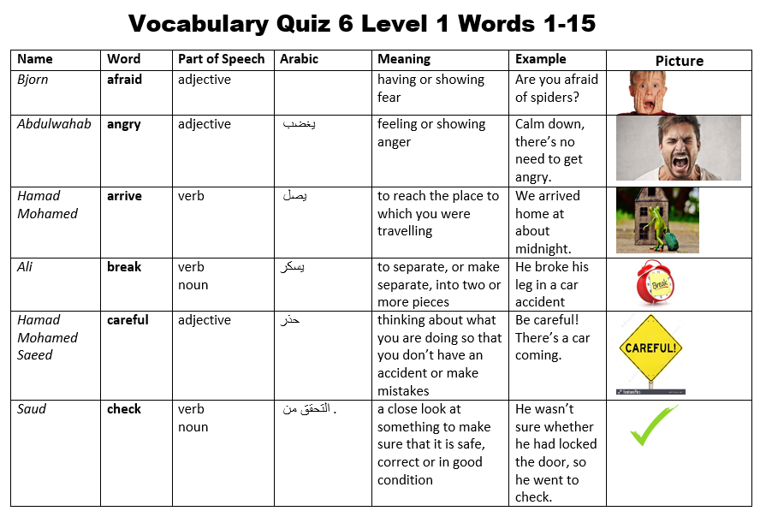

Slide 15
Acknowledge the 21CC skill
Affirm the skill
Build on it

Slide 16
bjorn.candel@hct.ac.ae

