Slide 1
Instant Writing Feedback in Class Using Padlet
Bjorn Candel FJM

Slide 2
Using Padlet in an Online Writing Class
Padlet is a flexible digital canvas tool that can be used for sharing and collaboration. It can easily be used in an online writing class, but works equally well in a face-to-face setting.
I will start off with a short demo where I show you how I interact with my students using Padlet in a writing class. To make it concrete, you’ll be my students. And you’ll be writing.
I will then introduce Padlet as a tool and show you how to create your own Padlet accounts. NB. If you already have a Padlet account, this will be the time where you can check your social media accounts. If you want to get a head start on the Padlet tool, here’s the sign-up page: https://padlet.com/
After that, I will show you:
how you can work with Padlet shelves in a writing class
how you actually set up the Padlet shelf page

Slide 3
Giving students writing feedback

Slide 4
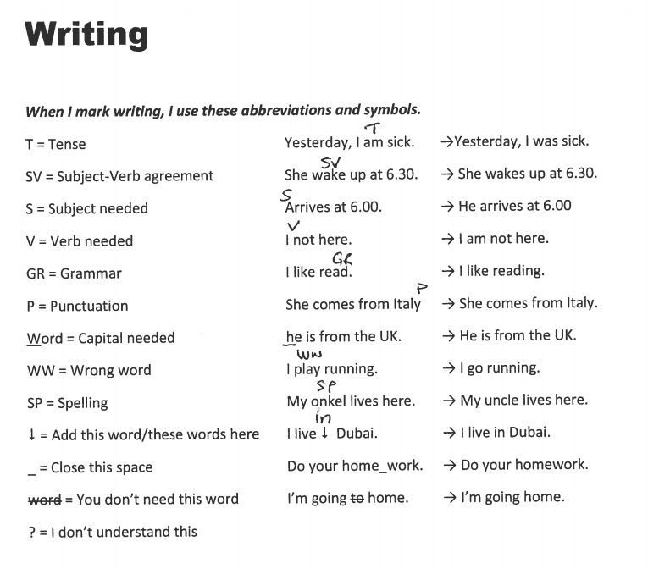
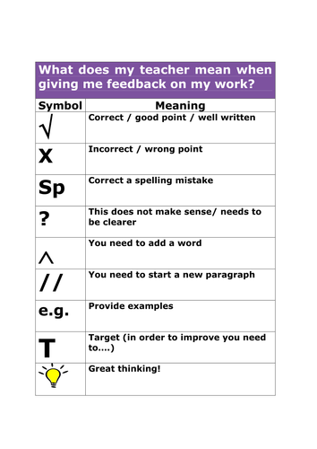
How the ideal teacher gives individual feedback on writing tasks
Using letters and symbols: V, T, WW
Video recording while marking
Collect student errors and ask students to correct them in class

Slide 5
Something is missing
What’s missing is an instant feedback loop that shows both you and the student that you are talking about the same thing.
And you want to save time!

Slide 6
How I use Padlet in a writing class
Enjoy the ride!

Slide 7
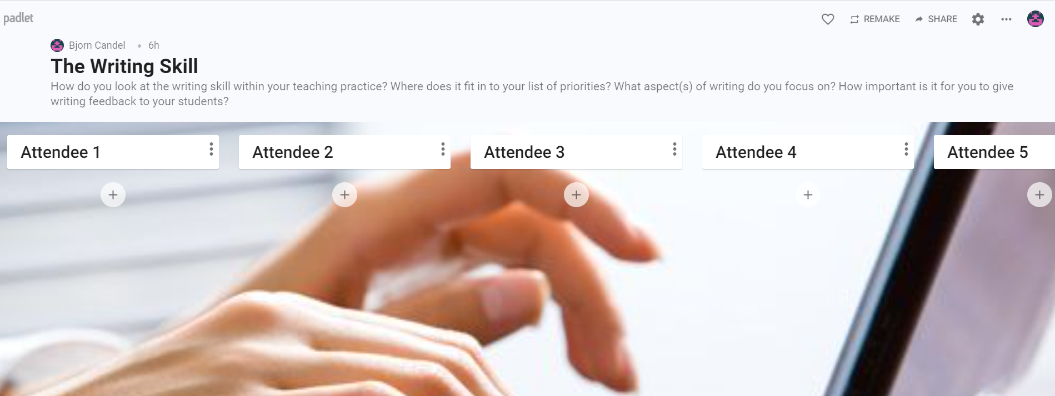
Instant feedback on writing
https://padlet.com/bjorncandelteac/writingskill2
Click on the plus sign under one of the untouched Attendee shelf tops
Write your name
Click on the plus sign under your name and answer the question at the top

Slide 8
A crash course in how to use Padlet
Learning outcome: Set up and share a Padlet with the participants in this session

Slide 9
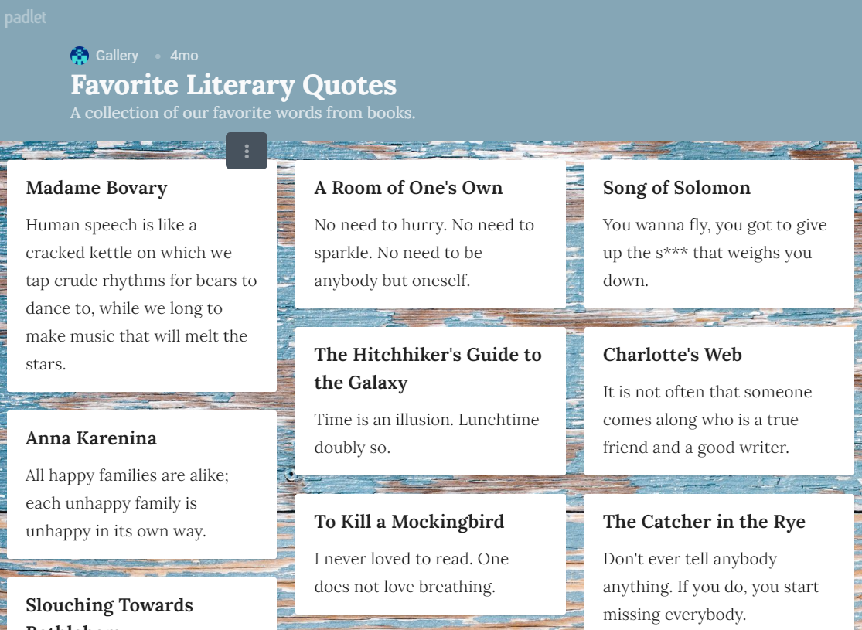
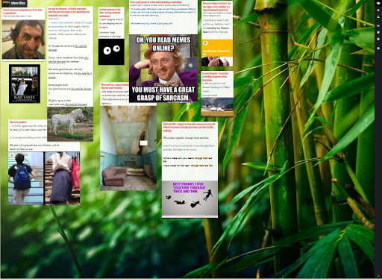
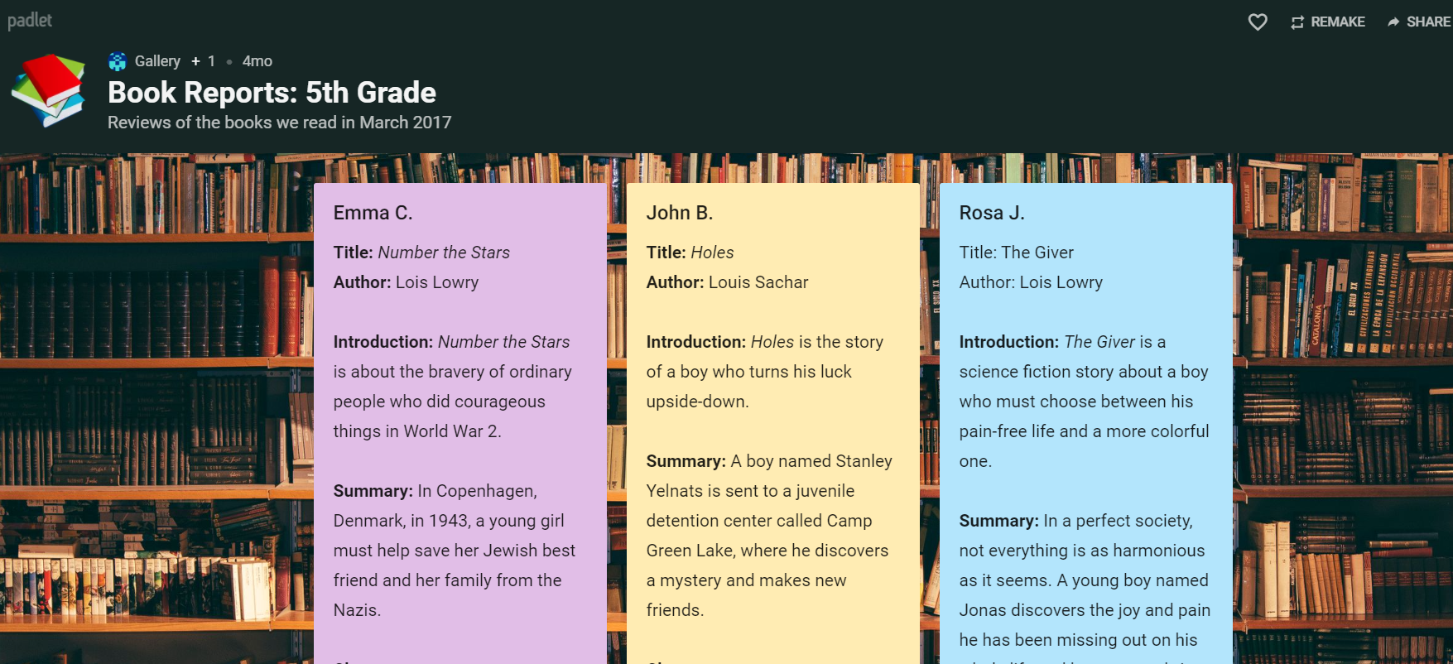
What is Padlet and how does it work?
Padlet is a free online collaboration tool
A Padlet wall is shared by using a unique URL
Any user/student can add content to the Padlet
Only the creator/moderator can edit, change or delete contributions
Students can only edit, change or delete their own contribution

Slide 10
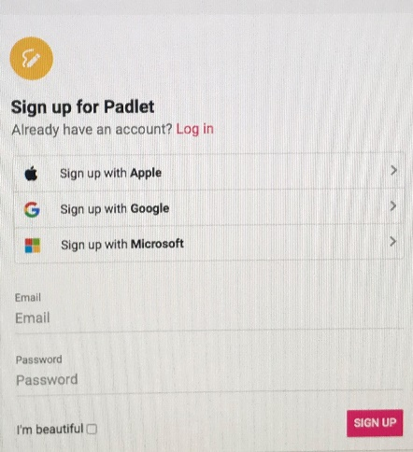
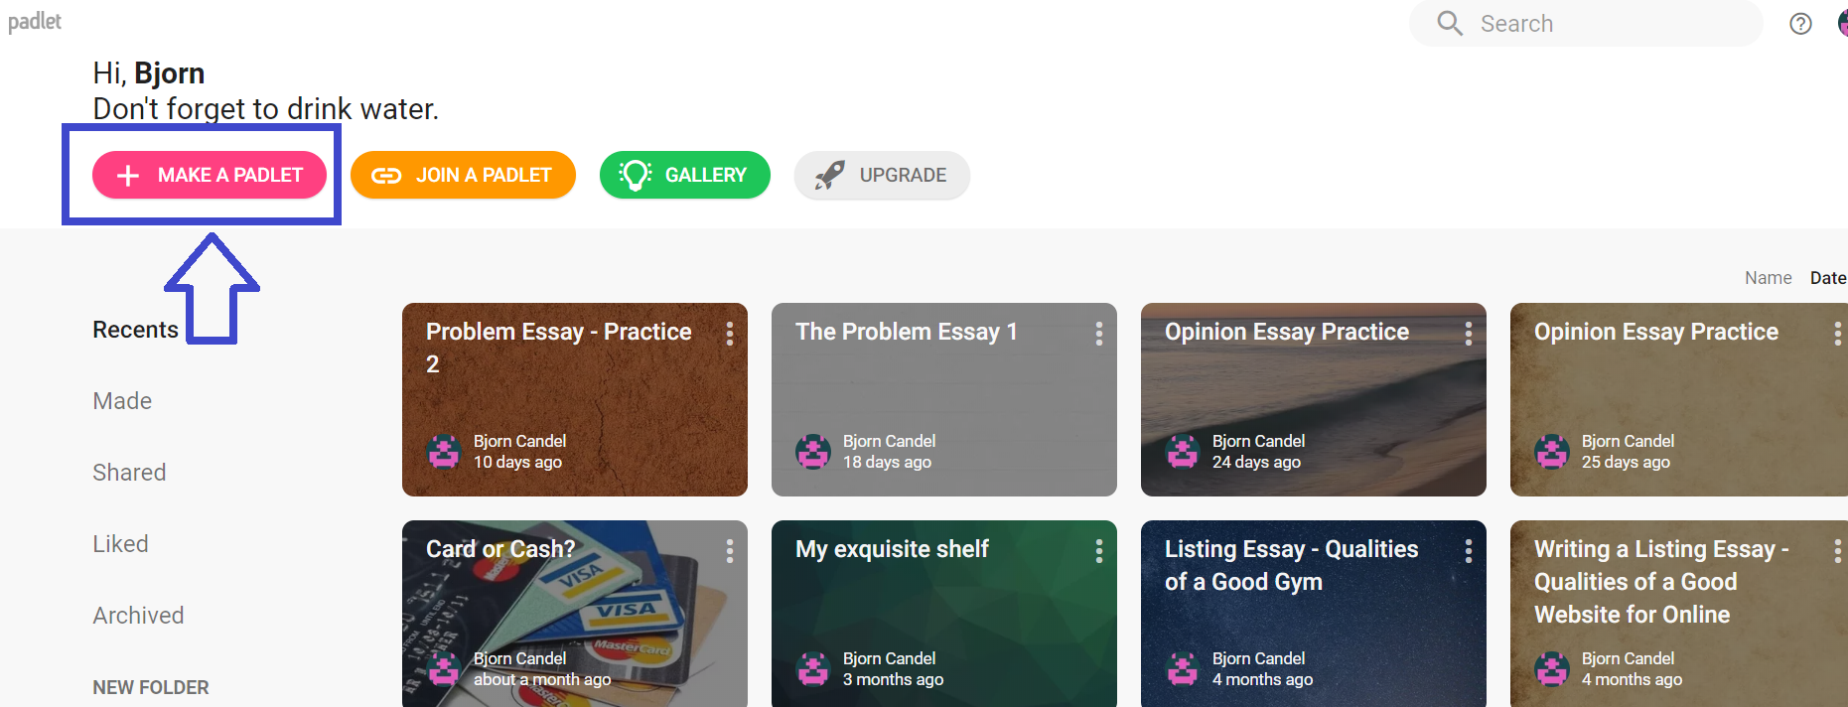
Creating a Padlet
Go to: https://padlet.com/
You can sign in with Google, Microsoft or Apple
Or you can create your own account
Once you’ve accessed your Padlet dashboard, click on MAKE A PADLET

Slide 11
Start by selecting the option for a basic Wall

Slide 12
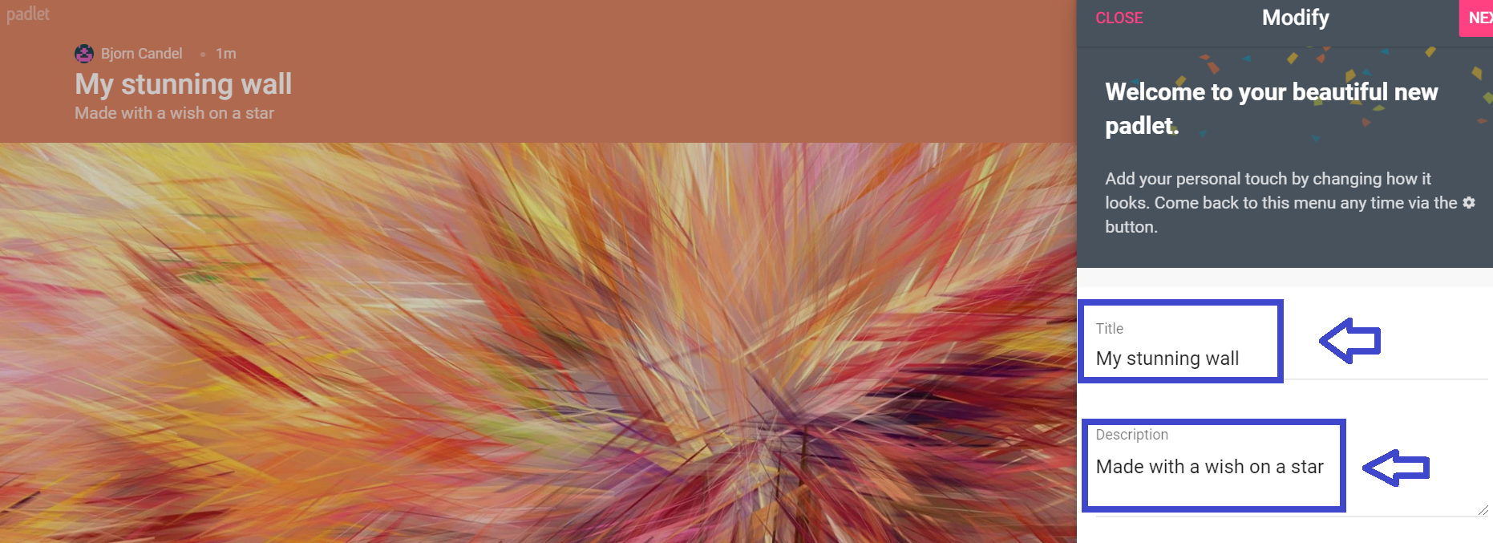
The basic settings: Title & Description
Edit the title and description

Slide 13
Modify your Padlet
Create your own user-friendly URL
Choose a background

Slide 14
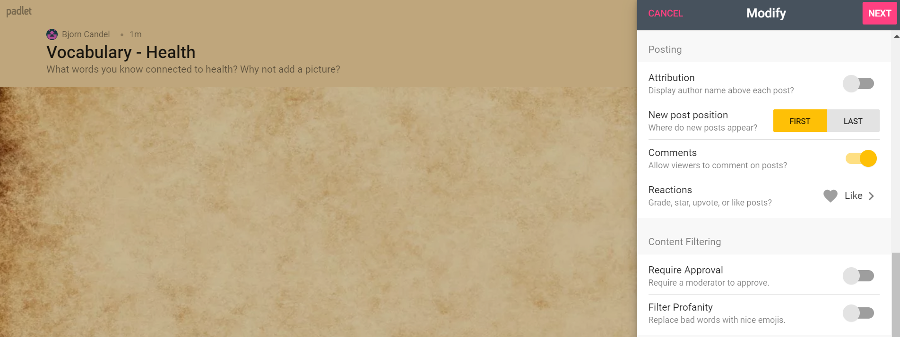
Decide on other settings
Change any other settings
Click NEXT and you’re done!

Slide 15
Task 1
Go the Padlet: https://padlet.com/bjorncandelteac/brainstormhealth
Try making your own Padlet using the Wall option
If you want to share it with the group, now’s the time! Put the URL in the chat

Slide 16
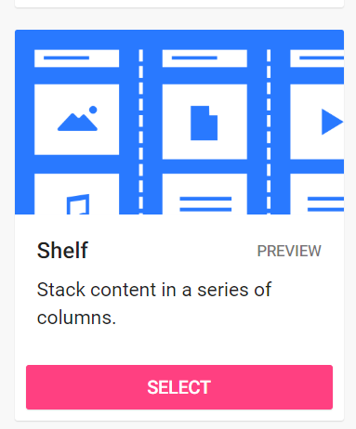
Working with shelves in a writing class
The end to hours of marking writing while giving more targeted writing feedback

Slide 17
Discovering the shelf option on Padlet

Slide 18
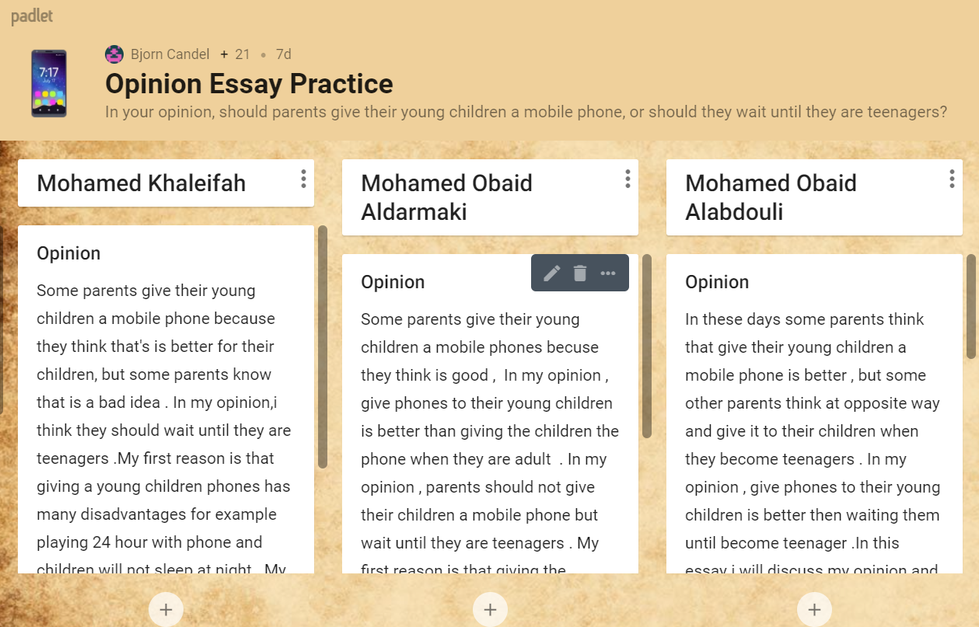
This is how it works
https://padlet.com/bjorncandelteac/mobilesforkids

Slide 19
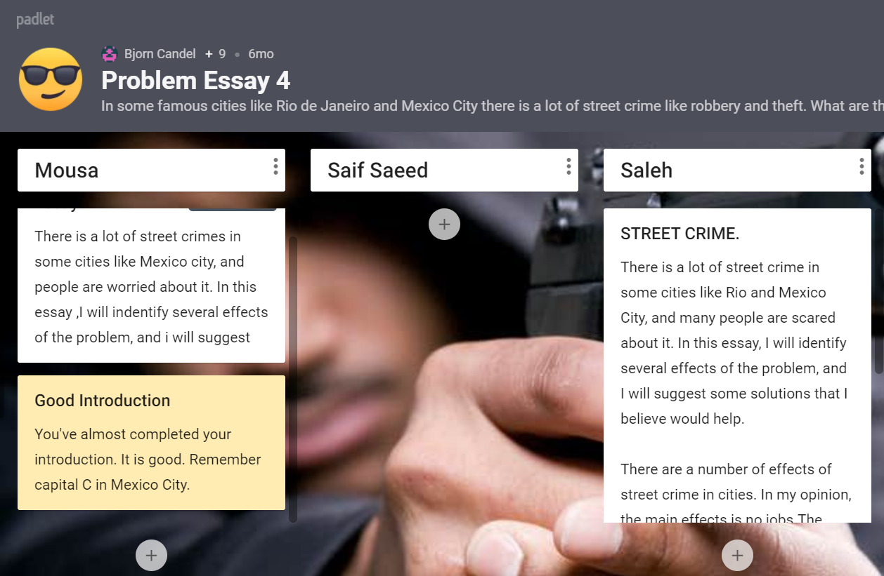
You still can leave feedback if you want to
https://padlet.com/bjorncandelteac/problem4

Slide 20
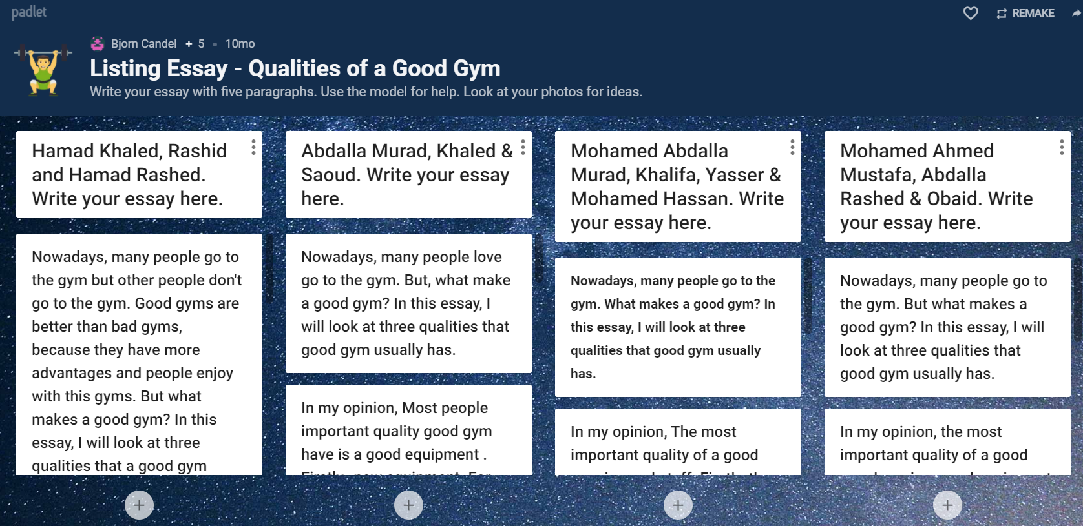
You can make it into a group task
https://padlet.com/bjorncandelteac/gymessay

Slide 21
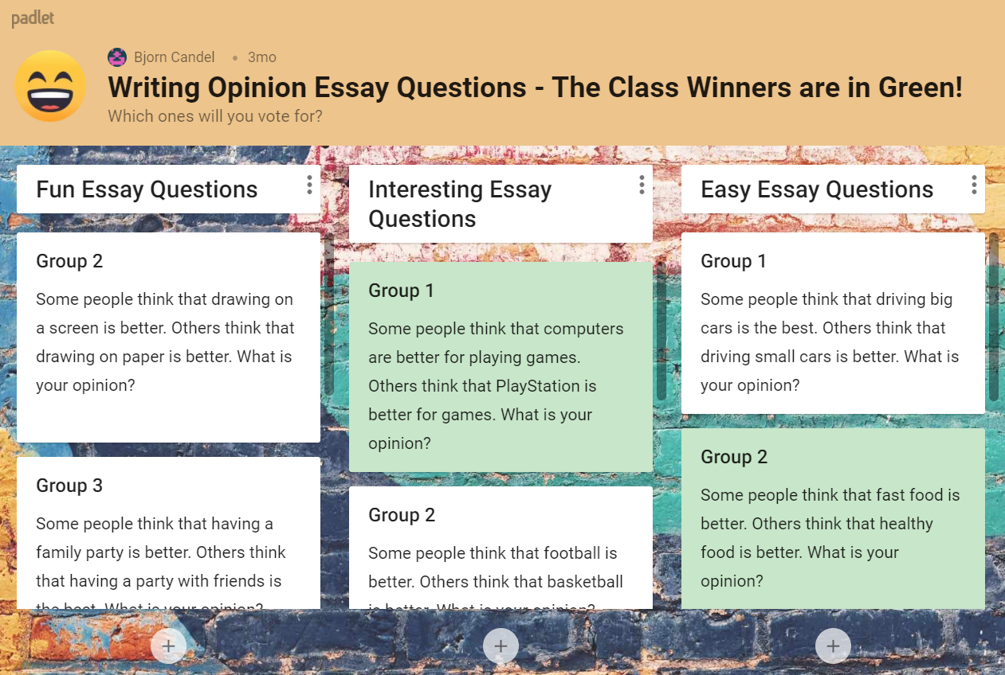
Students creating essay questions
https://padlet.com/bjorncandelteac/opinionessayvote

Slide 22
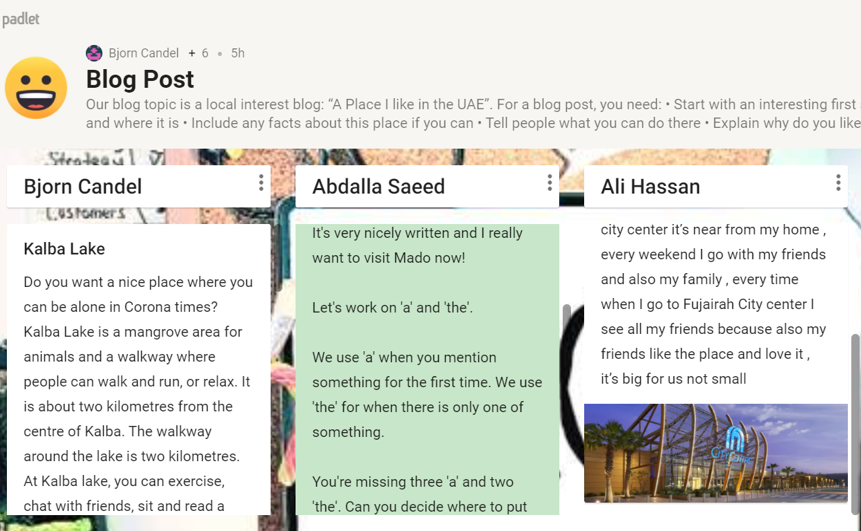
Process Writing
https://padlet.com/bjorncandelteac/blog1crn16646
Copy and paste the first draft and label it ‘Draft 2’
Give individual feedback/tasks to improve their work (use a colour for your comments)

Slide 23
Once in a while…

Slide 24
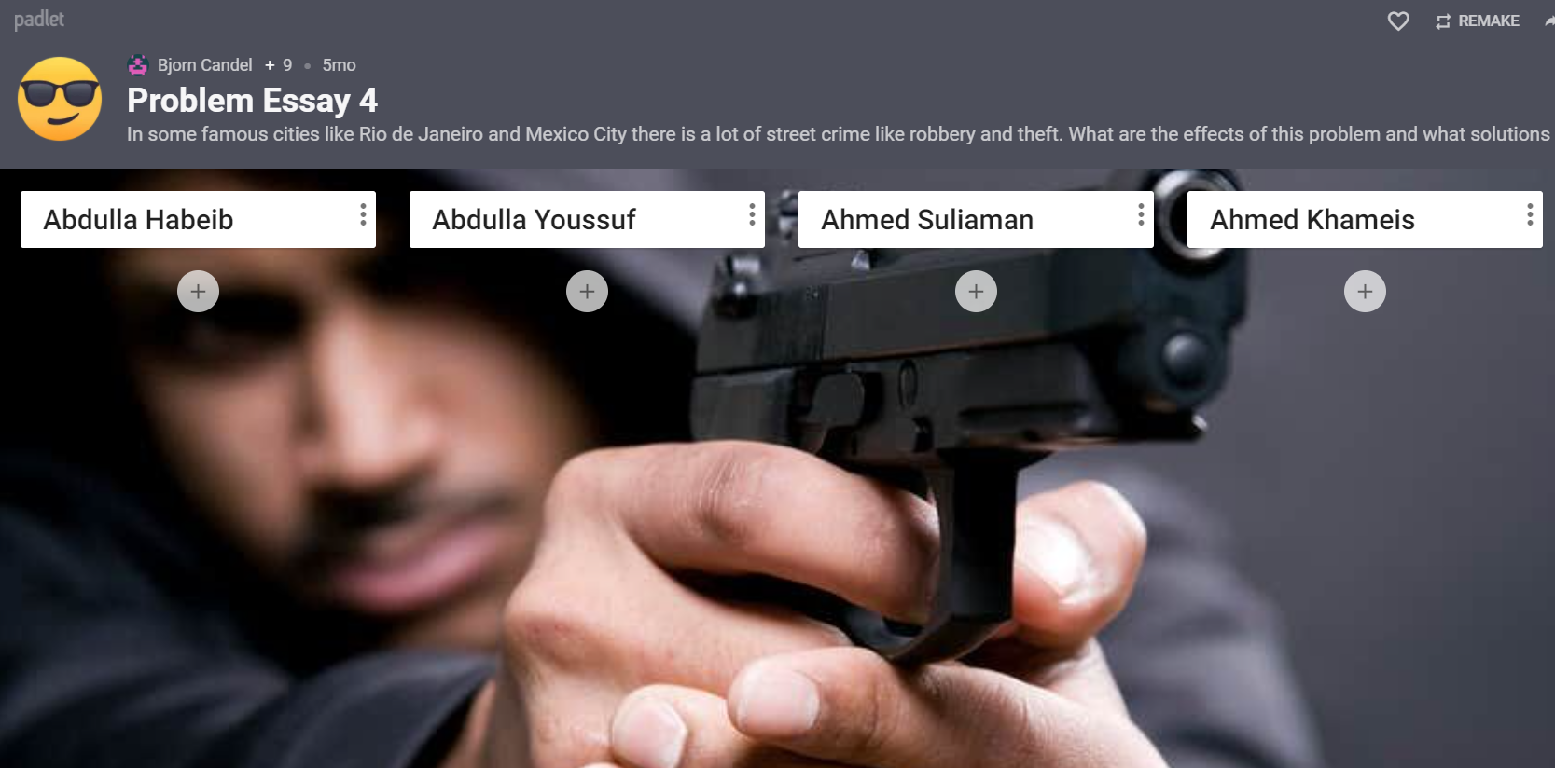
Who isn’t working?
https://padlet.com/bjorncandelteac/problem4

Slide 25
How to set up a Padlet with shelves
Learning Outcome: Know how to set up a session with a shelf Padlet

Slide 26
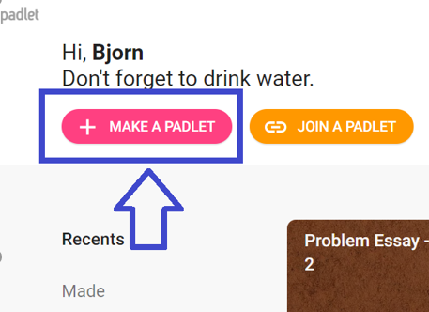
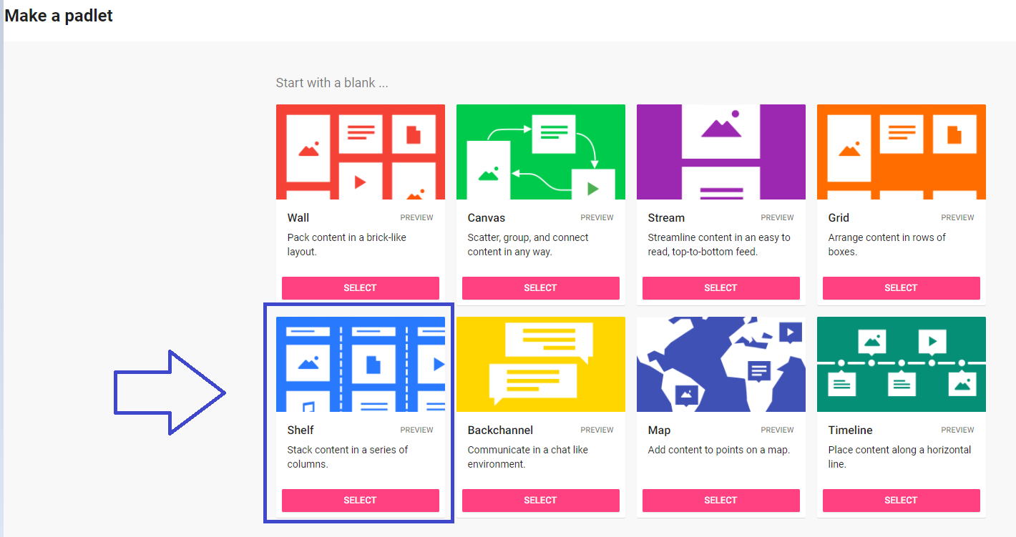
Create a Padlet for writing work and feedback
Prepare the Padlet by creating one column for each student before the class
To do this, select the Shelf option when you create a new Padlet

Slide 27
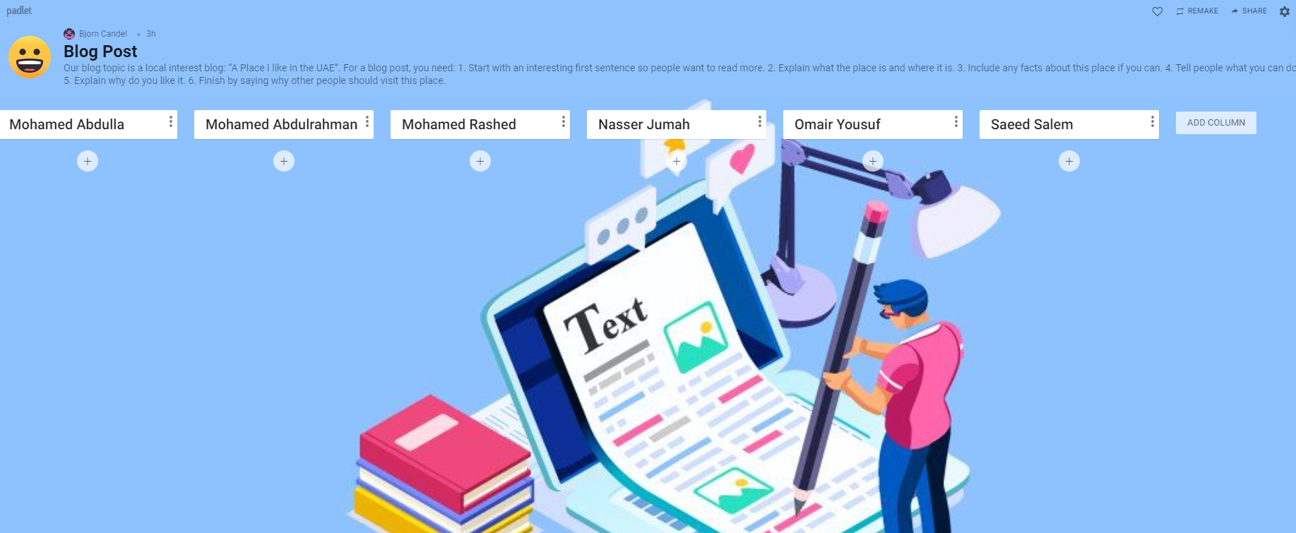
Steps to create a Padlet using the Shelf option
Set up title, description, background and URL
Write your first student’s name at the top of the first column
Click ADD COLUMN and add your second students
Keep doing this until your run out of students

Slide 28
Homework: Create a Padlet using the Shelf option
Make a Padlet using the Shelf option
Edit the Title and Description to fit your writing task
Create a shelf heading for each student

Slide 29
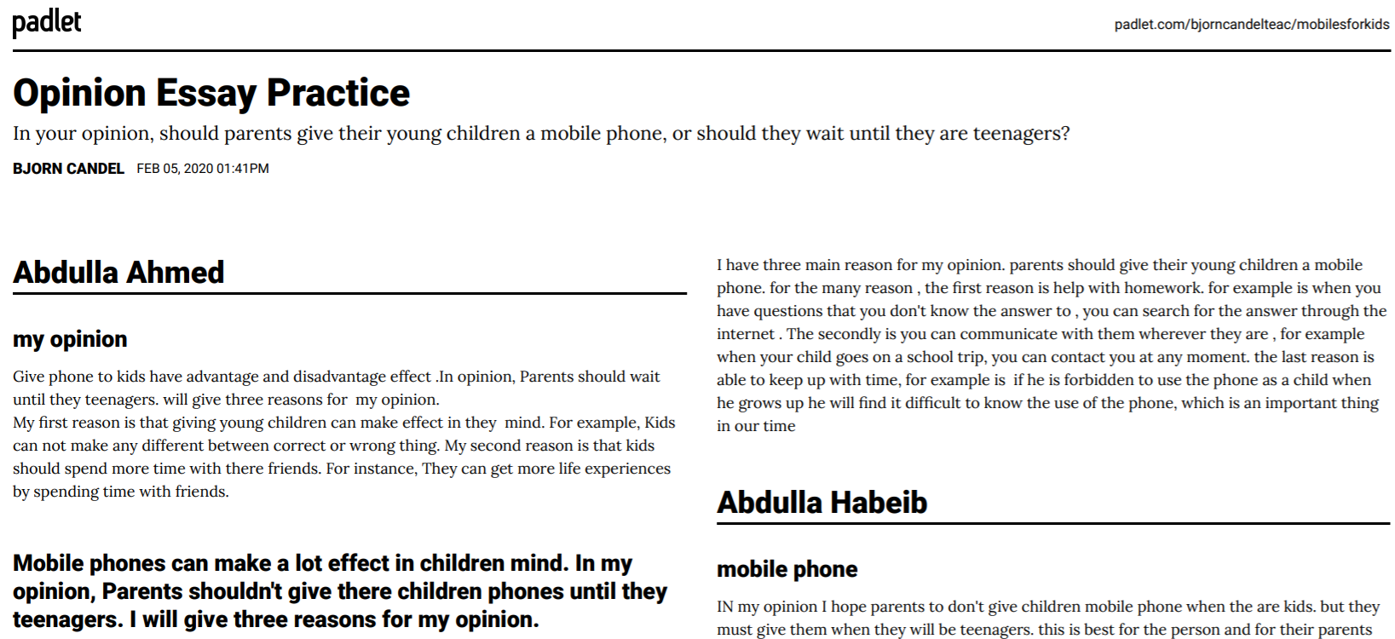
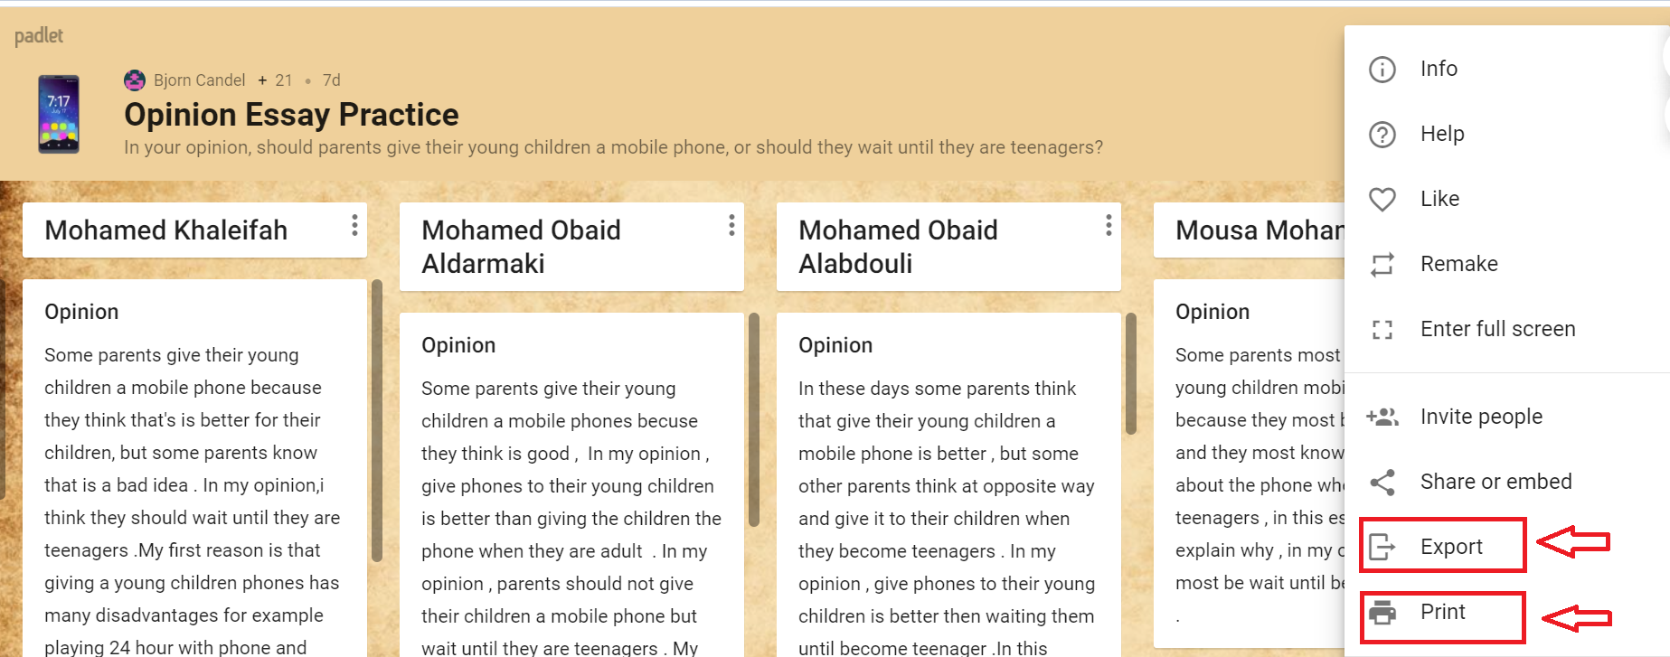
That’s the end? No! Print out or export the Padlet.

Slide 30
Any questions?

Slide 31
Bjorn Candel
bjorn.candel@hct.ac.ae

