Slide 1
Tidbits from ALLT 2018
Bjorn Candel – Fujairah Men’s College

Slide 2
Overview
Seppo
English Table
Grammar Blocks

Slide 3
Seppo
Gamification

Slide 5
Seppo
Work as a team – one device per team!
An iPad or smartphone works better than a laptop
Go to www.seppo.io
Sign up as a player using this game code: C289B6
Create a team name and add the names of the team members
PLAY!

Slide 6
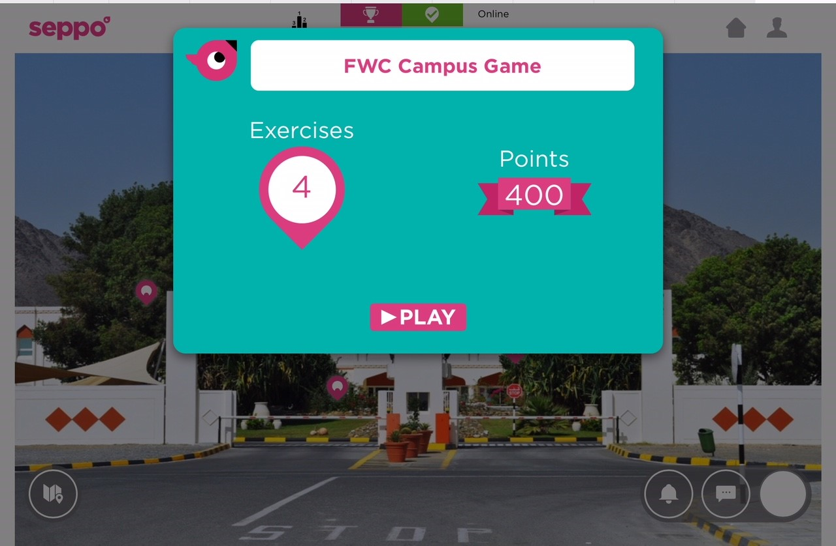
Do the exercises in any order you want by clicking on them

Slide 7
English Table
Task-Based Learning

Slide 8
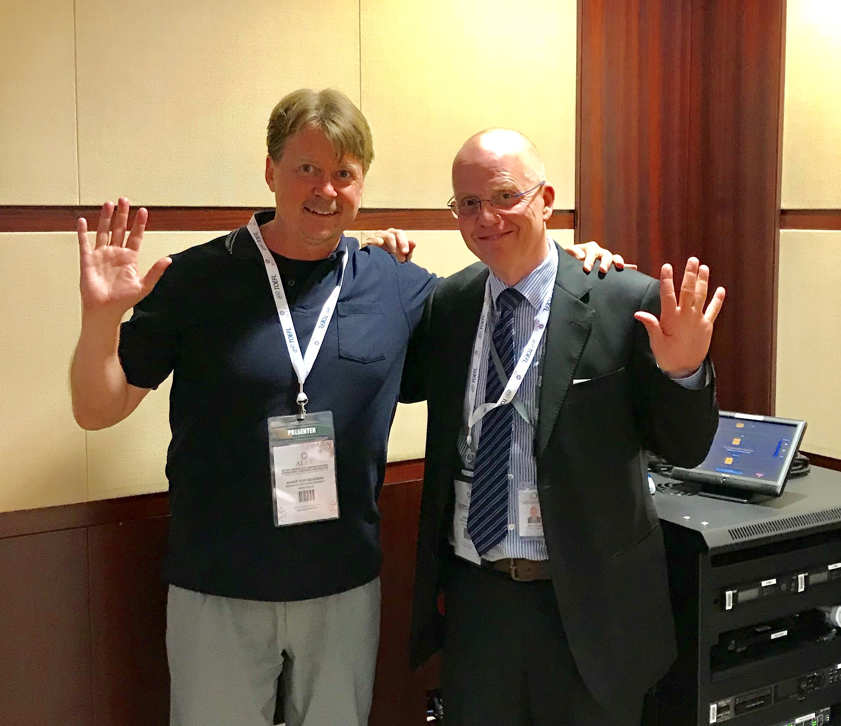
Todd Beuckens

Slide 9
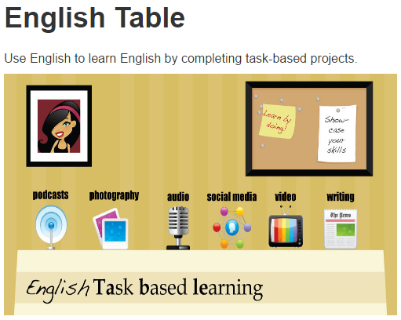
http://englishtable.org/

Slide 10
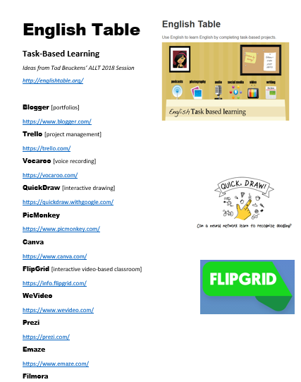
A Torrent of Fabulous Ideas

Slide 11
QuickDraw

Slide 12
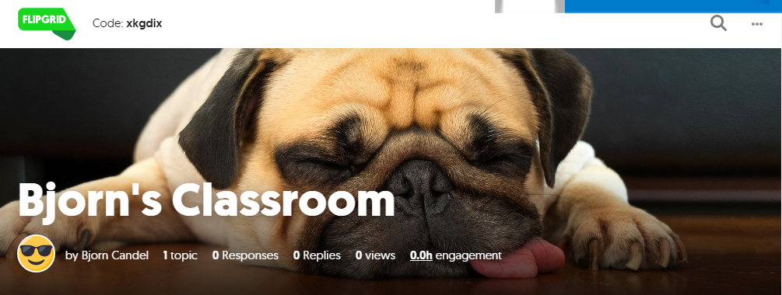
FlipGrid

Slide 13
Grammar Blocks
Gary Pathare’s Take on Grammar

Slide 14
Gary’s take on Grammar

Slide 15
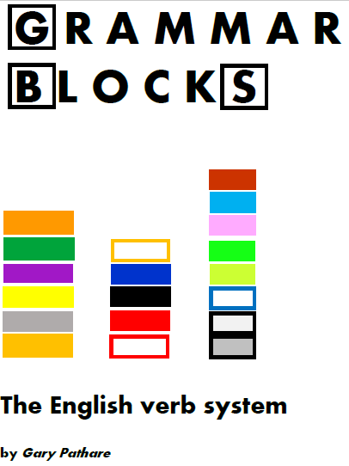
For a system to be useful and generative, it shouldn’t be too complex, nor too simple.
So 19 blocks.

Slide 18
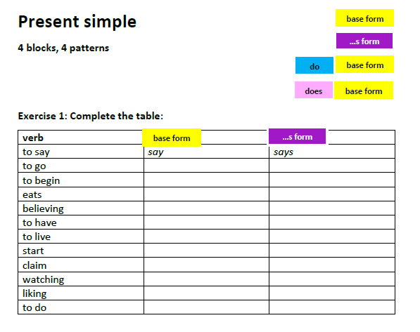

Slide 23
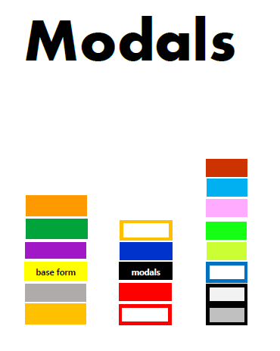

Slide 27
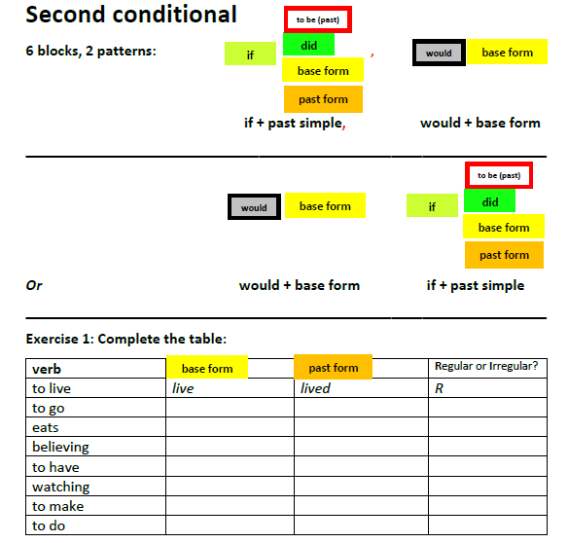

Slide 28
Questions?

