Slide 1
What can I do with TEDEd?
Bjorn Candel

Slide 2
What is TEDEd?

Slide 3
Overview
Work through a TEDEd lesson
Create your own TEDEd lesson
I will provide a video & tasks
Alternative: You choose your own video and create your own tasks

Slide 4
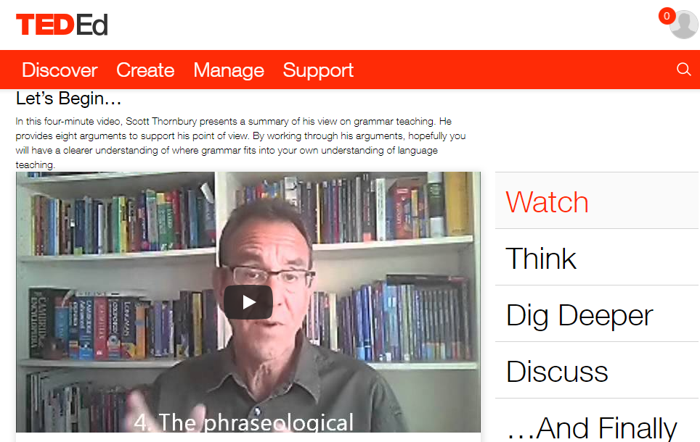
Learning
by Doing.
Try out this TED Ed Lesson!
You’ve got 15 minutes.
http://tinyurl.com/ted-ed-demo

Slide 5
STEP 1
Log on!

Slide 6
STEP 1
Go to http://ed.ted.com
Log on with your TED credentials
Create a TED account if you don’t have one

Slide 7
STEP 2
Create your first lesson.

Slide 8
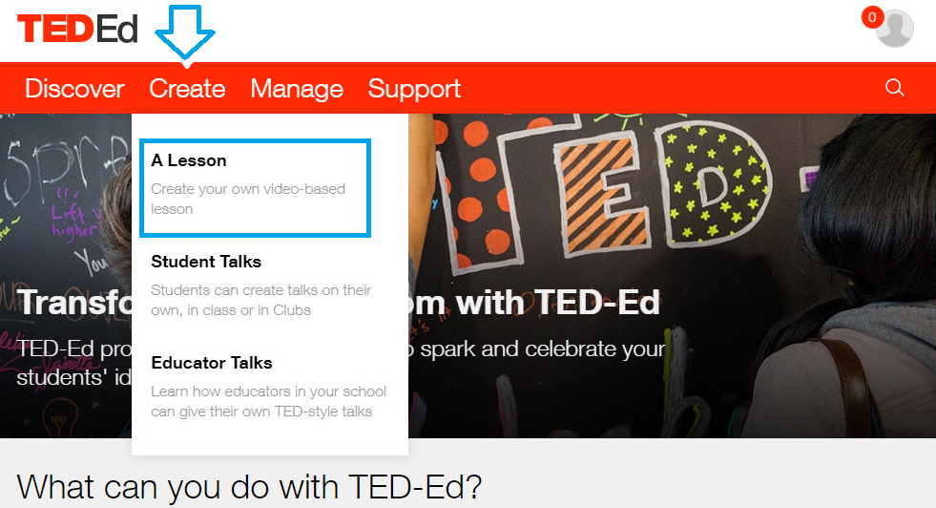
STEP 2

Slide 9
STEP 3
Decide on the video.

Slide 10
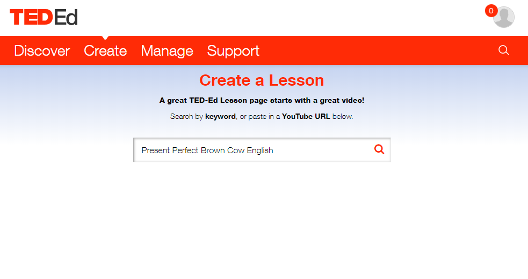
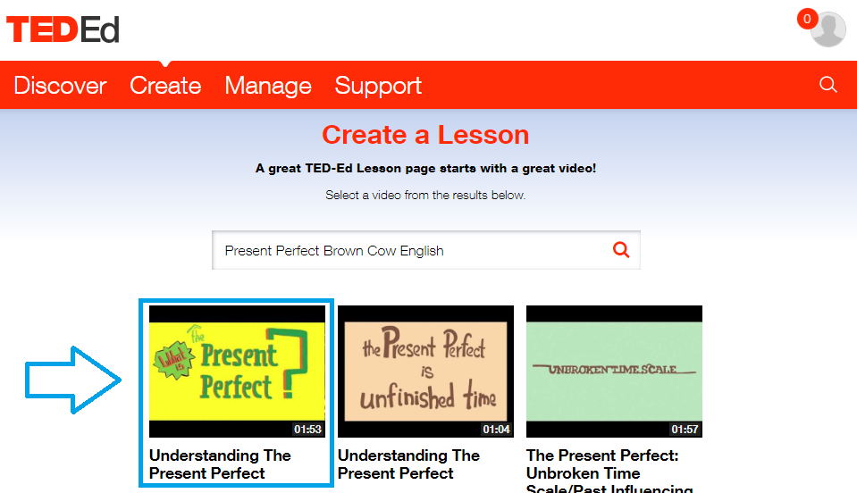
STEP 3
Search for a YouTube lesson by keyword or paste a YouTube URL in the field
Click on the video you want to use for your TEDEd lesson

Slide 13
STEP 4
Write an intro to your lesson.

Slide 14
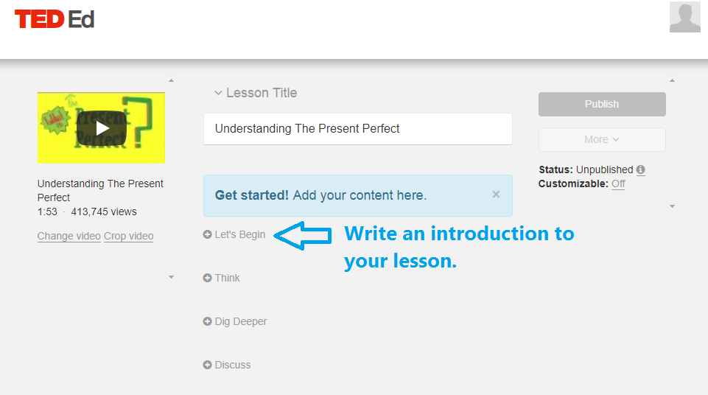

Slide 15
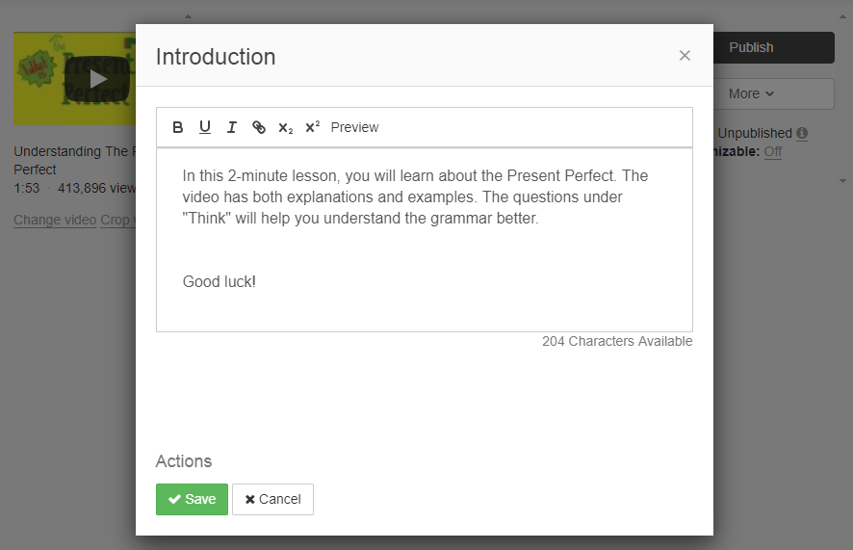
STEP 4
The introduction to your video lesson can help the students orientate themselves a bit, and get an idea of what to expect.
Here’s an example of an intro to a TEDEd lesson.

Slide 16
STEP 5
Create the tasks for your video lesson.

Slide 17
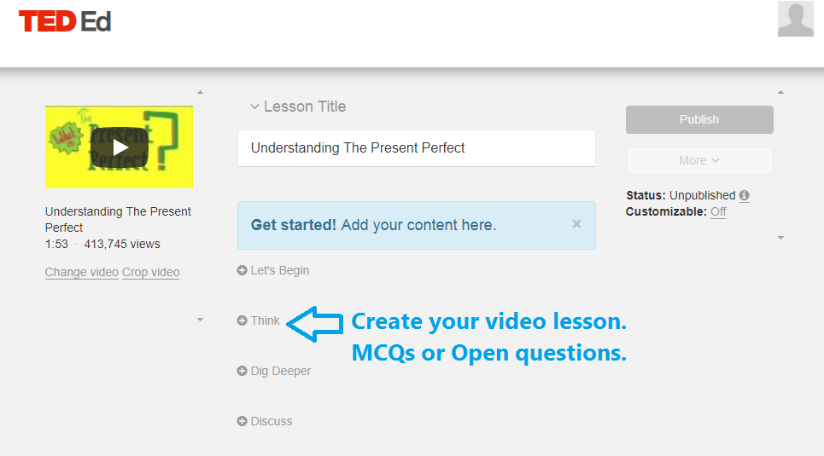
STEP 5
Now we’re getting to the meat and potatoes of your video lessons.
The task types you have are MCQs and Open questions.

Slide 18
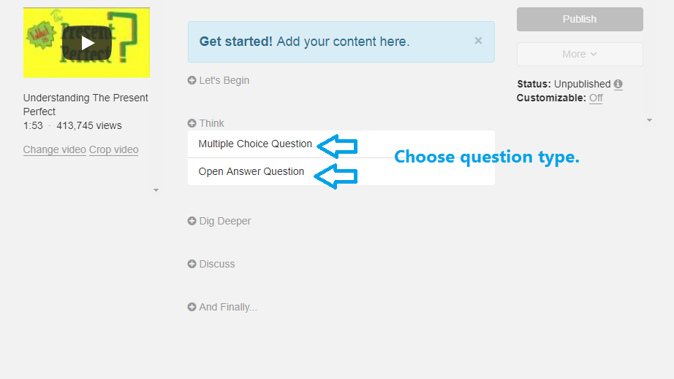

Slide 19
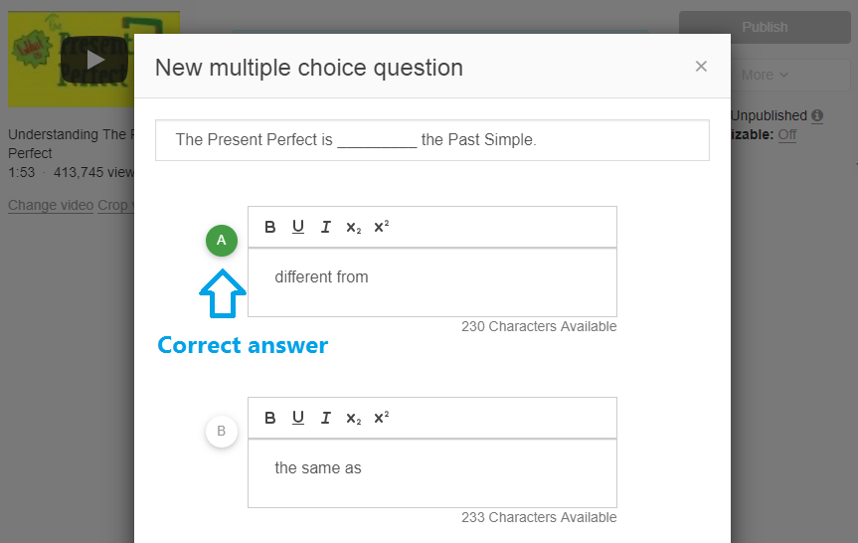

Slide 20
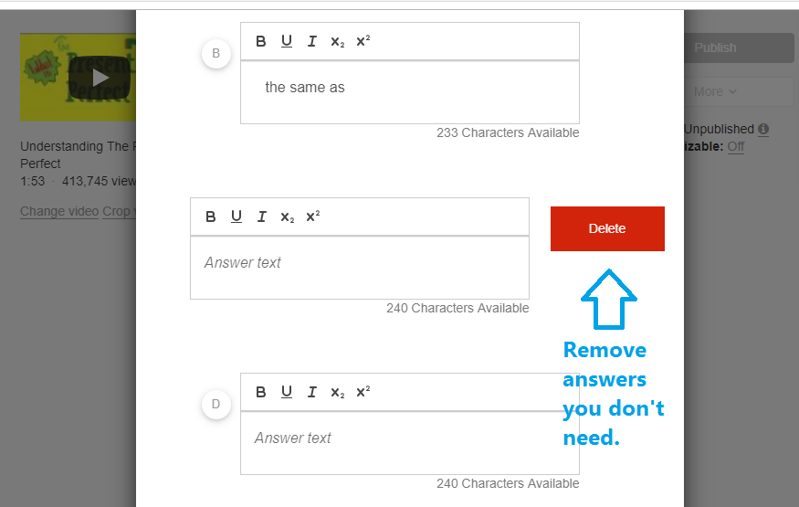

Slide 21
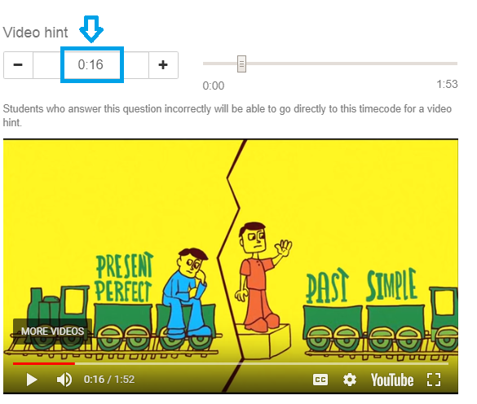
Create a video hint by locating where in the video the answer is given!
If a student gives the wrong answer, the Video Hint button will show.

Slide 22
STEP 6
Write an intro to your lesson.

Slide 23
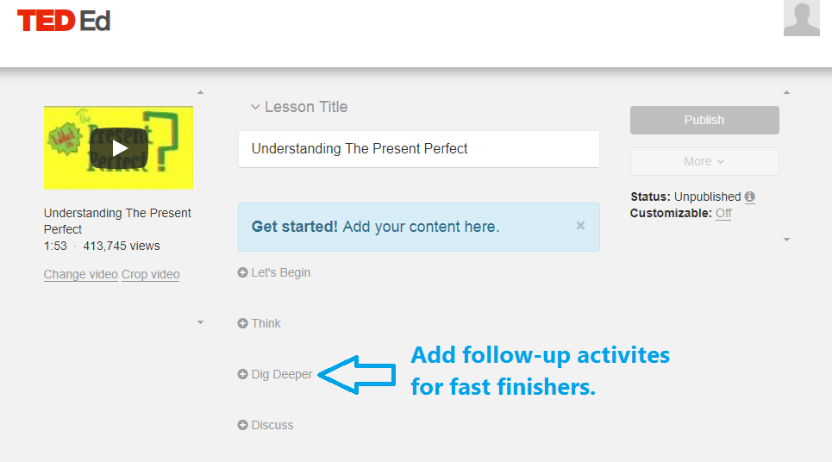
STEP 6

Slide 24
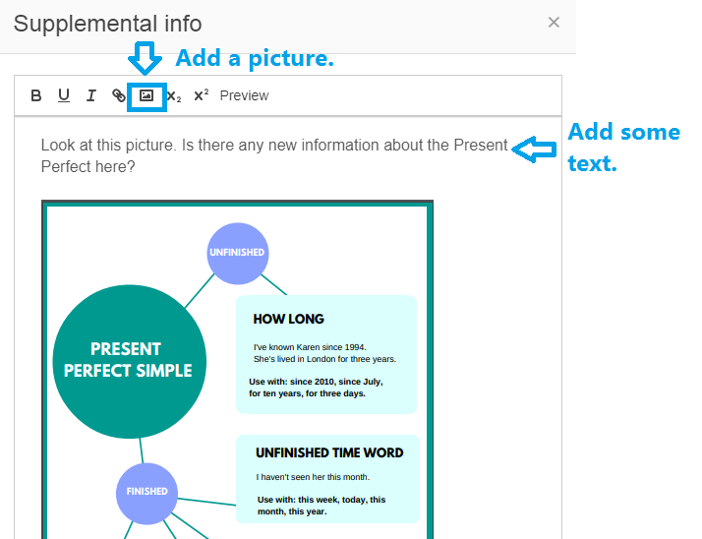

Slide 25
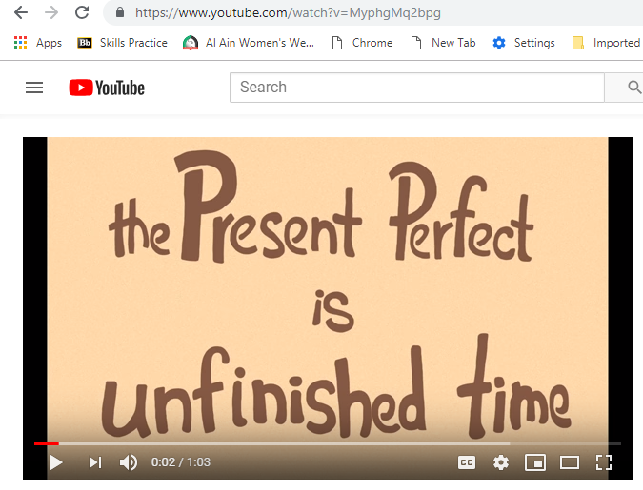
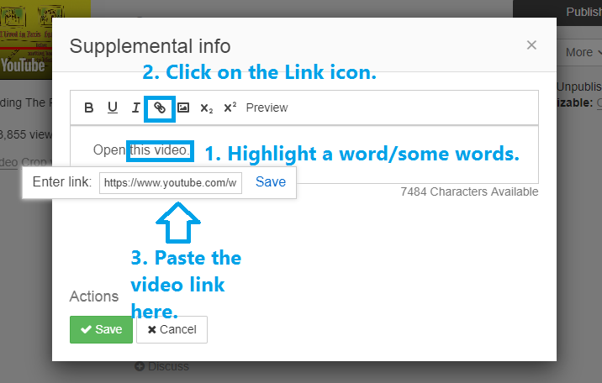

Slide 26
STEP 7
Add a Discussion Forum.

Slide 27
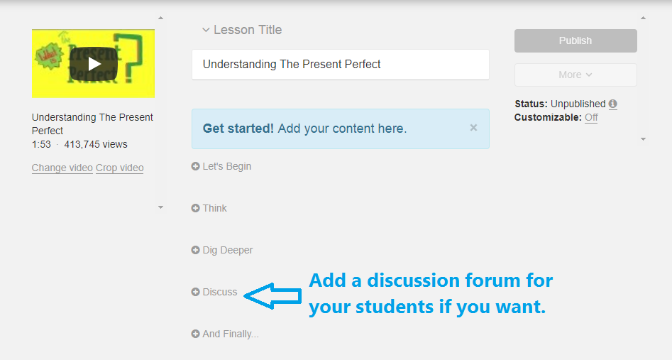
STEP 7

Slide 28
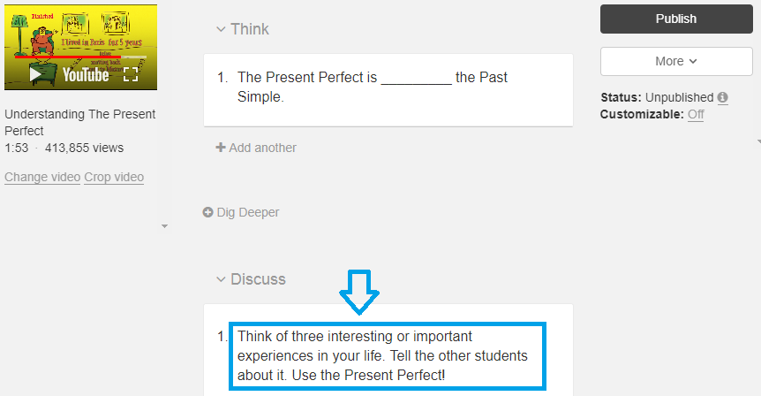

Slide 29
STEP 8
Wrap-up and homework.

Slide 30
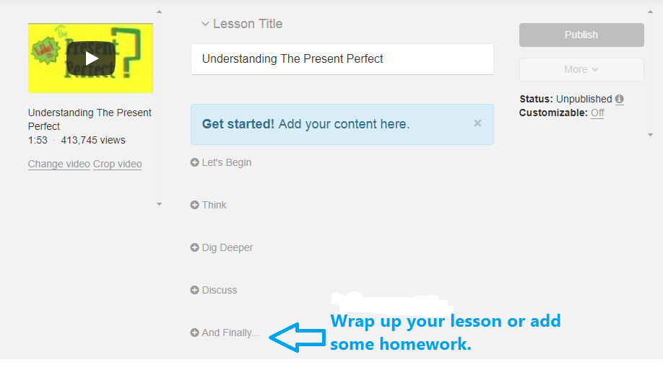
STEP 8
You have the same options of text, images, links and additional videos.

Slide 31
STEP 9
Publish!

Slide 33
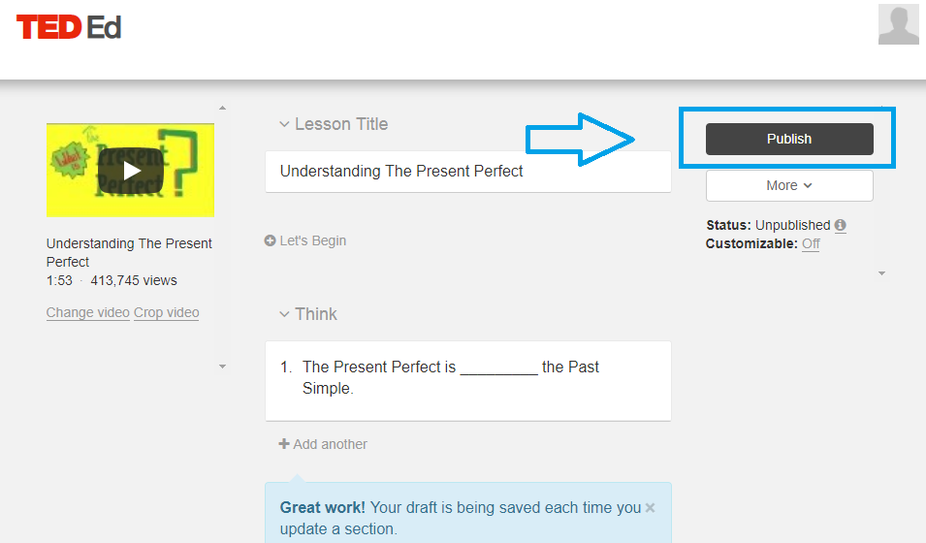
STEP 9
Decide if you want students to log in with TED or not (not is recommended)

Slide 34
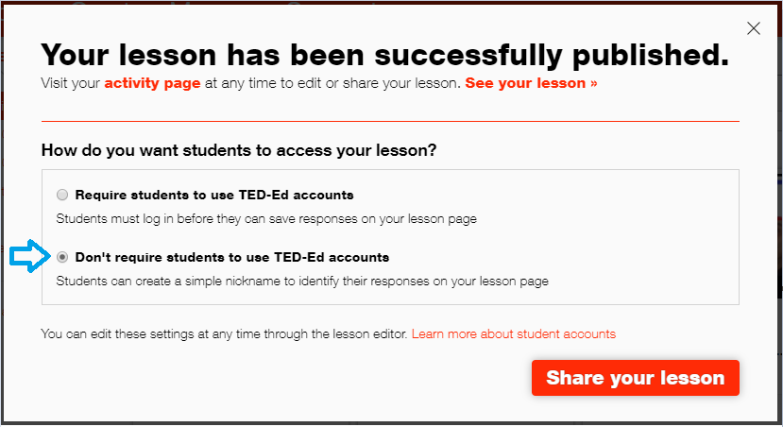

Slide 35
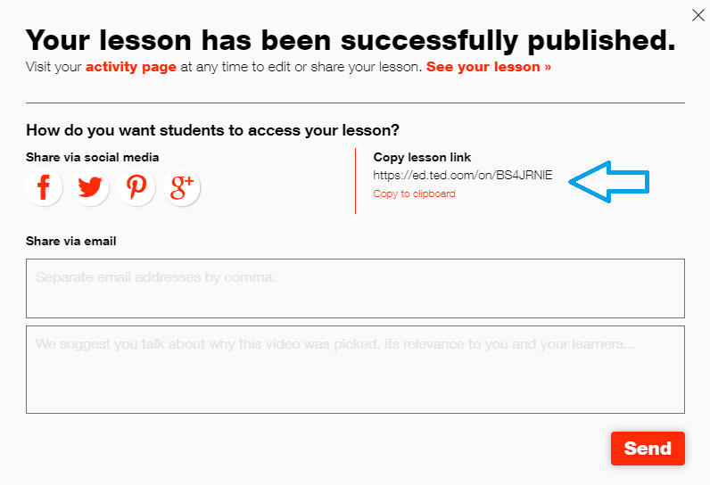

Slide 36
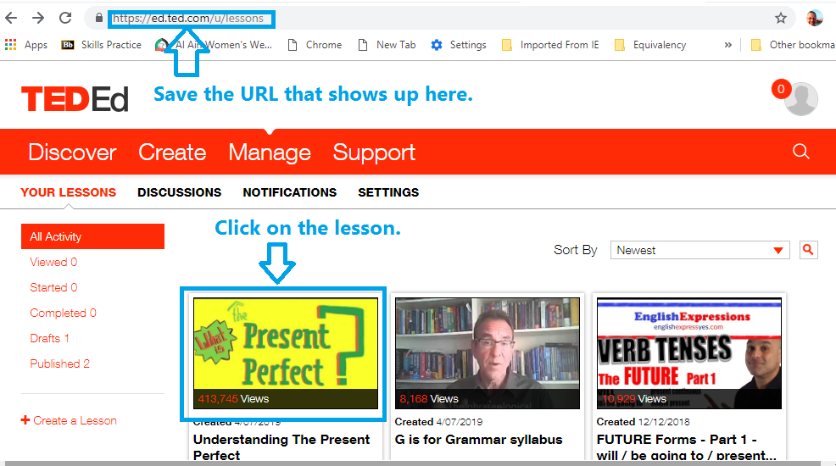

Slide 37
STEP 10
Review students’ work.

Slide 38
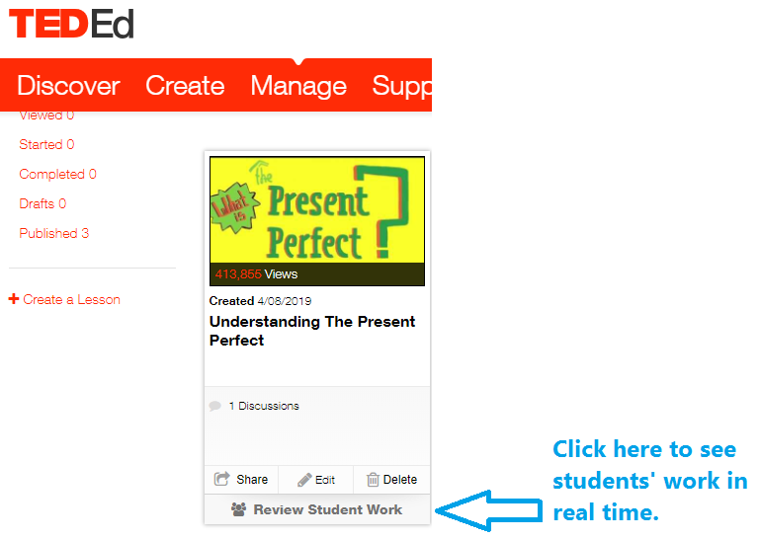
STEP 10
You can display students’ work in real time.

Slide 39
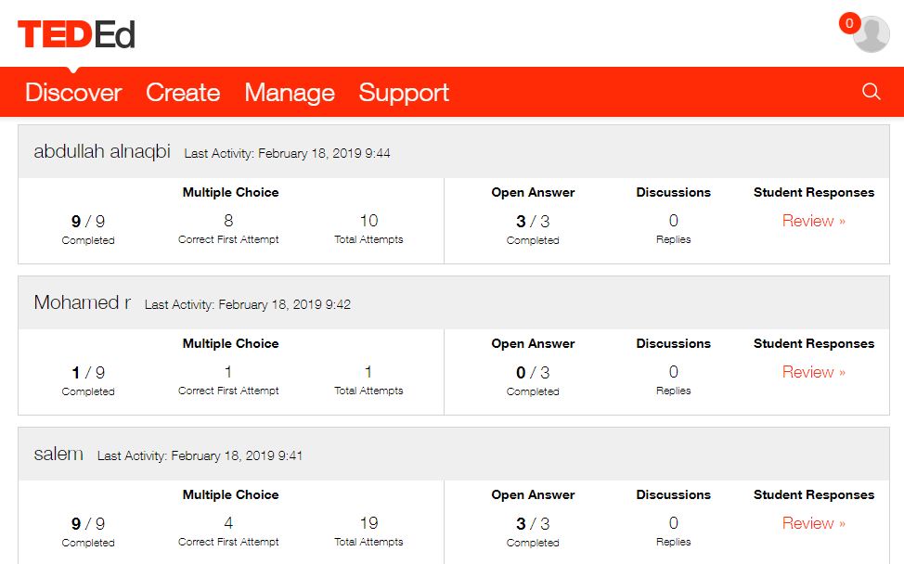
Summary of students’ scores

Slide 40
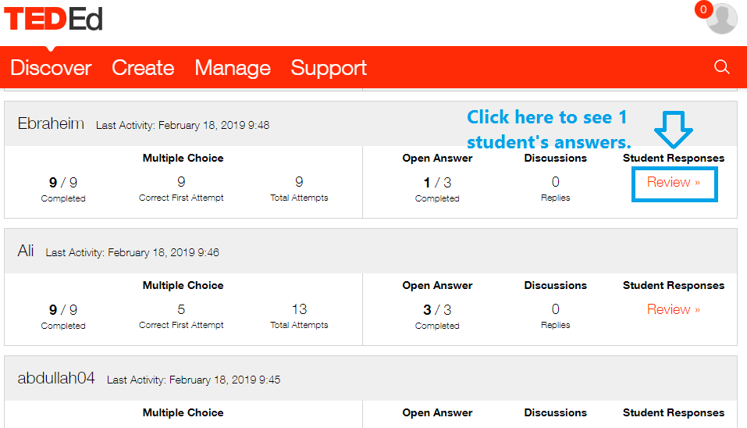

Slide 41
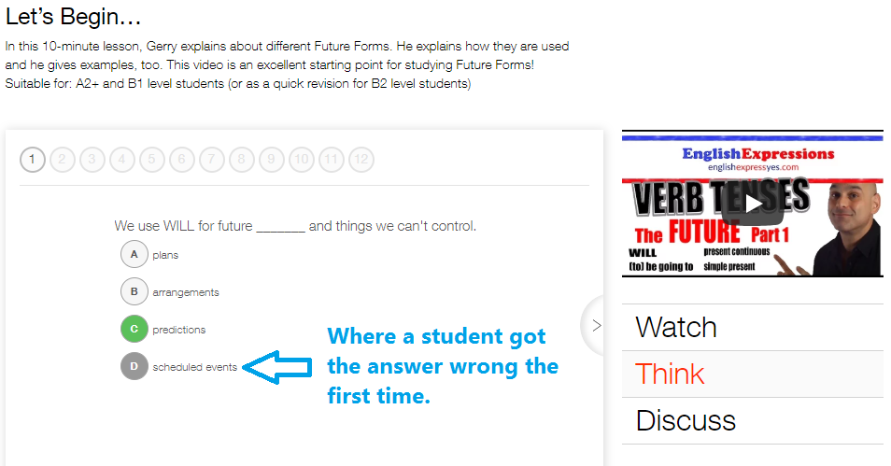

Slide 42
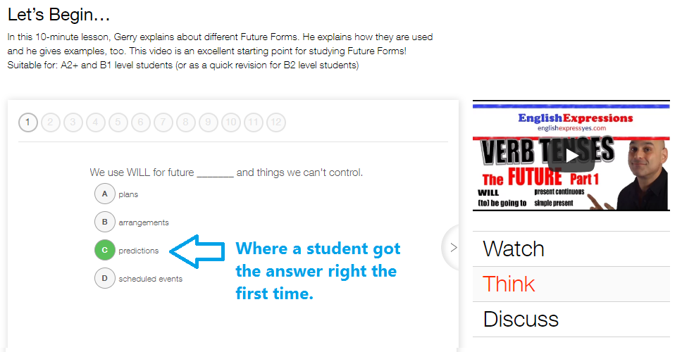

Slide 43
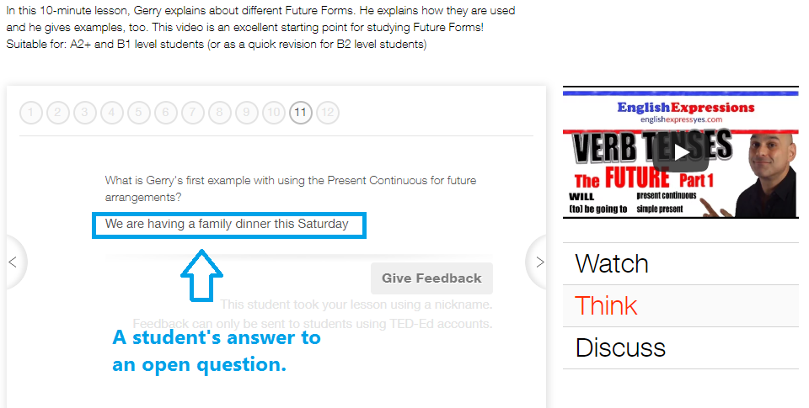

Slide 44
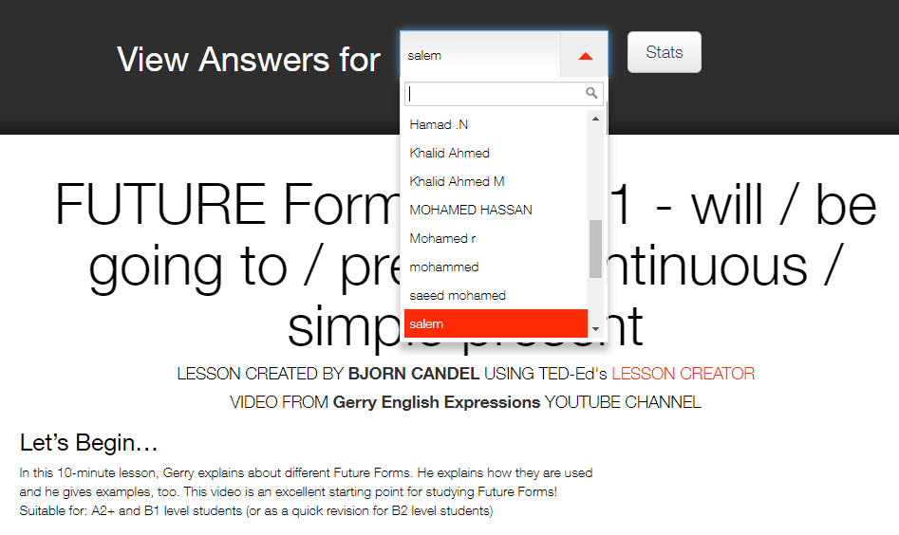
It’s easy to switch between students once you’ve opened the first review page.

Slide 45
bjorn.candel@hct.ac.ae

